Slide 1
CoreBIS Training Overview
A to Z CoreBIS

Slide 2
Notes:
We all know APRA, but important to get a deeper understanding of the APRA reporting framework and the SBR
Will provide an updated pack at the end of the project to give them screen grabs from their CoreBIS instance

Slide 3
APRA Components
Taxonomy
Plain English Taxonomy
Form versions
Form variants
Changes to Forms
Validation rules
Derivation rules

Slide 4

Standard Business Reporting (SBR)
  SBR – Standard Business Reporting
  http://www.sbr.gov.au/
  SBR works by using a dictionary of standard terms (Taxonomy) needed for each report. These terms are used by government agencies for reporting, and by Software Developers.
  i.e. Standard definition used between all government departments, so when an organisation states a value by an SBR element it is known what is included and excluded from that value.
Notes:
Definitional taxonomy, reporting taxonomy.
The idea here is we tag your data to the definitional taxonomy and then it can be re-used, so unless there is a material change, new data item etc that is used technically speaking you should be able to re-use that data point.

Slide 5
SBR – What is it?
Reporting taxonomy
Introduced by Government to ease the reporting burden
ASIC
Client Data
Definitional taxonomy
APRA
ATO
Notes:
Still working through the ASIC taxonomy at present

Slide 6
SBR Gateway
Form Attributes
Client Data
SBR Tref ID’s and Dimensions
Form Attributes
D2A
Form Attributes

Slide 7
Taxonomy
Automatically updated each time D2A is updated within CoreBIS
CONTROL POINT -> CoreBIS database ingests your D2A files providing a 100% reconciliation to your D2A instance each reporting period
NEW FEATURE - > Delta analysis of new taxonomy against prior taxonomy to inform clients of changes

Slide 8
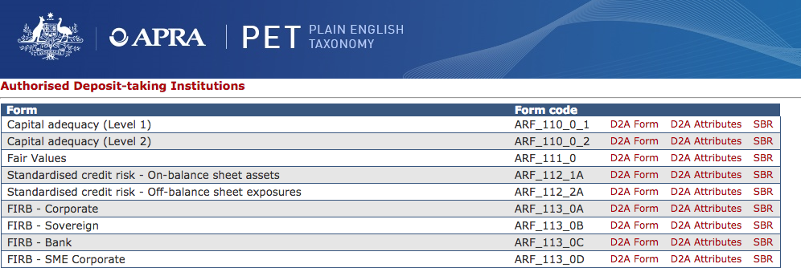
Plain English Taxonomy
Notes:
Provides a snapshot of all Forms for each industry. Each Form has the D2A attributes and the SBR componentry within it.
Key message - > this is all found within CoreBIS and is always reflective of the latest PET released by APRA.
Note - > APRA cannot currently version the PET which means some of the Forms may represent future based delivery

Slide 9
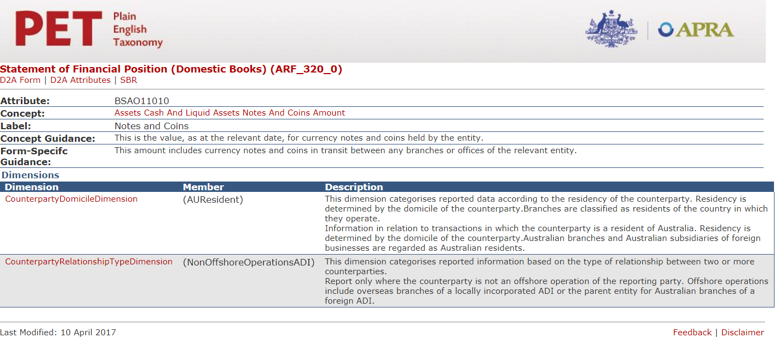
Concept + Dimensions = Reporting attribute
Concept
Dimensions
Notes:
Talk through the PET. Look at the members of the dimension so the audience really grasps this understanding before moving into the tagging. Probably start with the 320 as an easy starting point.

Slide 10
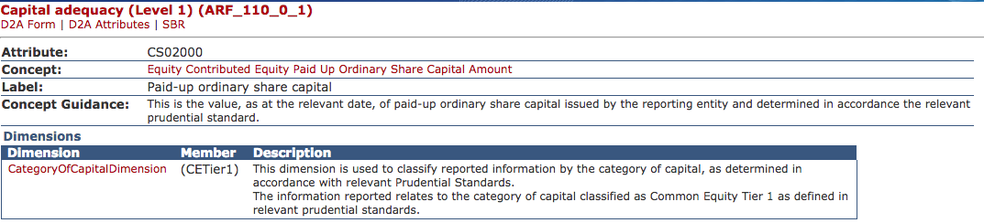
PET continued
Attribute – as seen on Form. Used in mapping, they will cease to exist for all future dated APRA forms
Concept – key SBR building block, really indicates the measure of what is reported
Label - plain English reference
Concept Guidance – further commentary about the concept
Dimensions – can be multiple dimensions used to create the data point. The member of the dimension represents the data point that is required to be mapped to for this particular reporting item.
So dimensional member + concept = reporting item

Slide 11
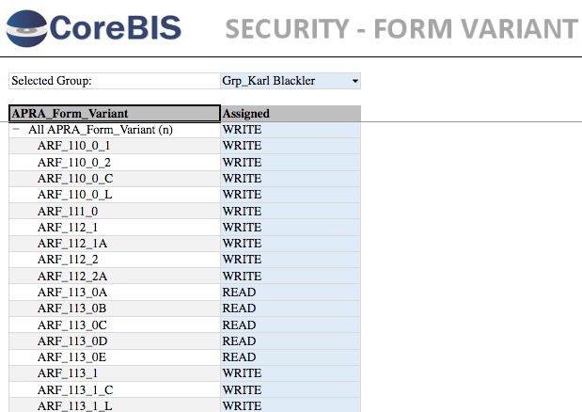
Form Variants
Form Variant = level 1
Form variant = level 2

Slide 12
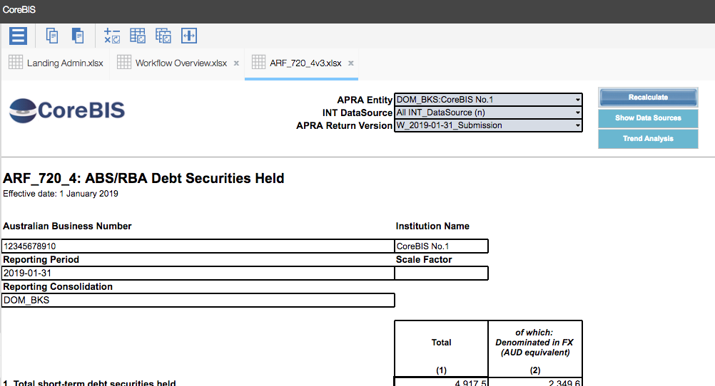
Form Versions
Form Version can be seen here as the extension to the Form number ie version 3

Slide 13
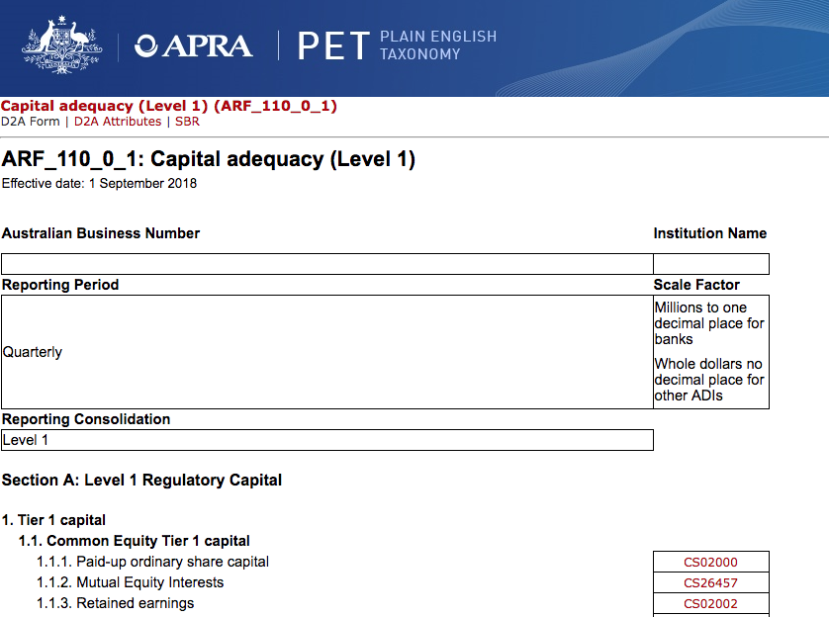
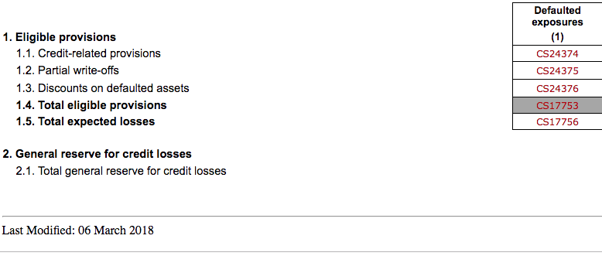
Changes in Forms
Form layout changes will be updated by Cortell via an update package
Notes:
You will note there is no reference on the PET to the Form version. The Form version can only be seen within the taxonomy.
Updates to Form layouts will be provided by Cortell through our subscription service, so each time you go into CoreBIS you will see the latest Form version, however of course you will always have access to the old Form Version.

Slide 14
Validation rules
-> Validation rules are updated each reporting period into CoreBIS
Notes:
Talk to different types of rules

Slide 15
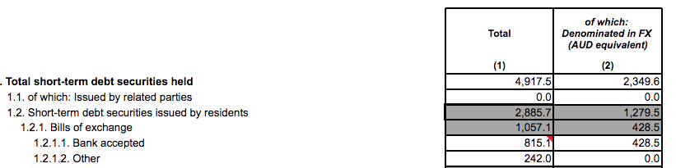
Derivation Rules
-> Derivation rules updated into CoreBIS each reporting period
Notes:
Derivation rules are not actually found in D2A

Slide 16

CoreBIS Introduction

Slide 17

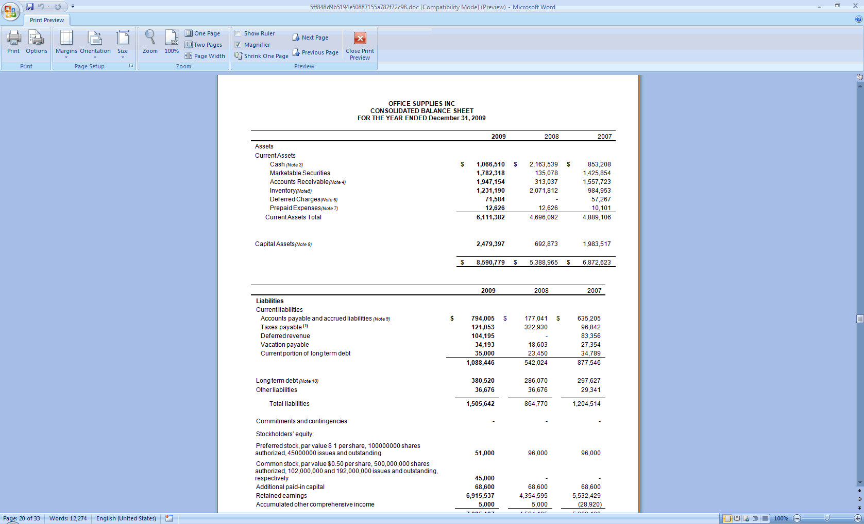

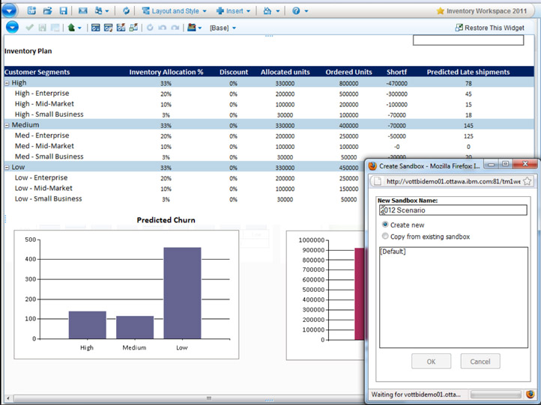


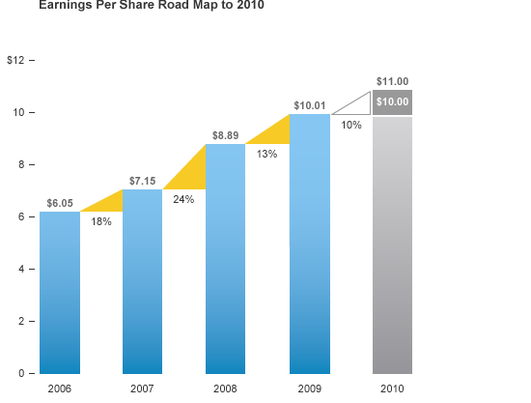
Architecture Diagram
CoreBIS
CoreBIS
Engine
Multiple outputs
Multiple formats
Source system(s)
Client Base cubes
Warehouse
Data
Notes:
High level architectural view of CoreBIS.. Each client will have their specific data model however data flows will follow the rudimentary pathway consistently.

Slide 18
Version Integrity
APRA taxonomy
Business data
Tagging
Mapping
Validation/ derivation
Manual adjustments
WORKFLOW
Notes:
Think of each of these as individual building blocks

Slide 19
Data Flow
Base
Tagged
Source / DWH
Report
Tagging
Mapping

Slide 20
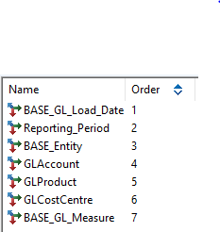
Base Layer
Base
  The Base layer is a 1 for 1 representation of the source data. This data is business data before any additional tagging and mapping has taken place.
  The Dimensions used in the base layer have to be chosen to support the tagging, so a great deal of planning is involved to ensure this layer includes the required dimensions.
  Each dimension can not use hierarchies as this goes against the as-is / as-was versioning methodology required for Regulatory reporting. However multiple dimension can be used representing the different hierarchy levels.
Source / DWH
BASE_GL

Slide 21
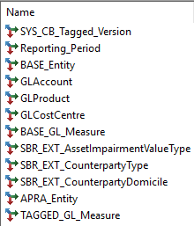
Tagging / Tagged
Base
Tagged
  The Tagged layer has the additional SBR dimensions required to map to the APRA Attributes on the form.
  Each SBR dimension will use a tagging placed against 1 or more business dimensions to determine its tagged element.
  This tagging can have up to 3 levels (specific to broad).
  e.g. L1 = GLAccount / GLProduct
  L2 = GLProduct
  L3 = BASE_GL_Measure
  The Tagged Measure dimension contains the SBR Concepts and is tagged in the same way as the other SBR dimensions.
BASE_GL
TAGGED_GL
Tagging
Notes:
Contained within the word document

Slide 22
Tagging pre-requisites
  A great deal of design is required in the following areas;
  Base Cube has the right business dimensions for tagging to SBR Dimensions.
  Tagged Cube has the right SBR dimensions to support the attributes the data is mapped too.
  Knowing what data source goes to which forms.
  Grouping of Attributes / Concepts and SBR dimensions to feed particular form attributes.

Slide 23
Mapping
  The Mapping layer uses the SBR framework provided by APRA to map to the Tagged cubes.
  The APRA Taxonomy supplies the Attribute to SBR linkage, so this is used to map to each attribute.
  The mappings can be overwritten depending on the data layer and requirements. An organisation may choose to implement non SBR dimensions, and hence mapping can be performed manually.
Tagged
Report
Mapping

Slide 24
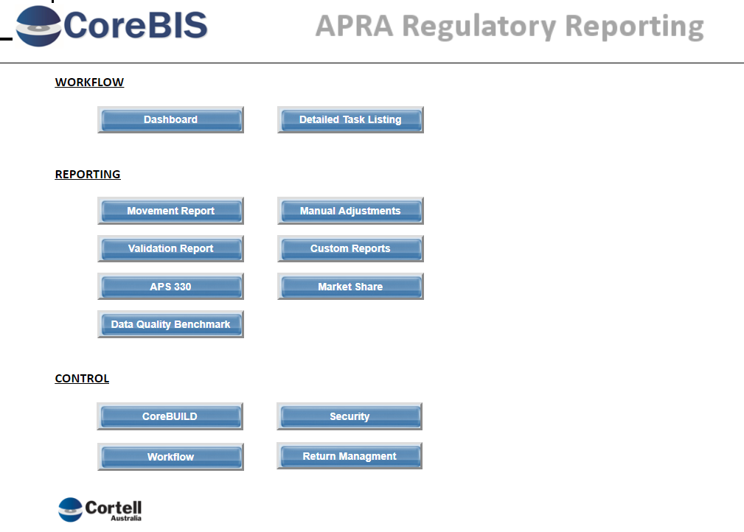
CoreBIS Navigation

Slide 25
CoreBIS Components - Workflow
  Workflow drives:
    creation of new period
    data loads (n.b. these can also be scheduled)
    mapping and tagging of data
    review and submission process for a period
    Workflow controls the version integrity and audit trail for CoreBIS.
  Workflow Dashboard
    Graphical representation of the task status for the period
  Forms
  The excel/websheet representation of the APRA PET version of the form with numbers populated.

Slide 26
CoreBIS Components - Reporting
  Movement Reporting
  Validation Reporting
  Manual Adjustments
  Market Share
  APS 330
  Data Quality (EFS assurance)
  Custom Reporting
Notes:
Validation Reporting
Checking of the data in the system against APRA’s own ruleset to ensure conformance and mandatory compliance.
Manual Adjustments
Allows adjustments to be added with date stamp and user comments for tracking. Provides manual adjustment reporting for review and audit.

Slide 27
CoreBIS Components - Control
  CoreBUILD
    Create and edit dimensions and cubes
    tagging
    Mapping
  Security
    Setup users and user groups
  Workflow
    Create and generate workflow for period
    Control resubmissions and ad-hoc workflows
  Return Management
    Provides D2A data feeds

Slide 28
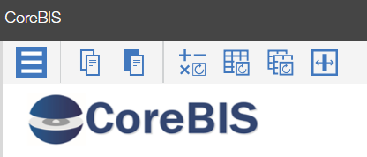
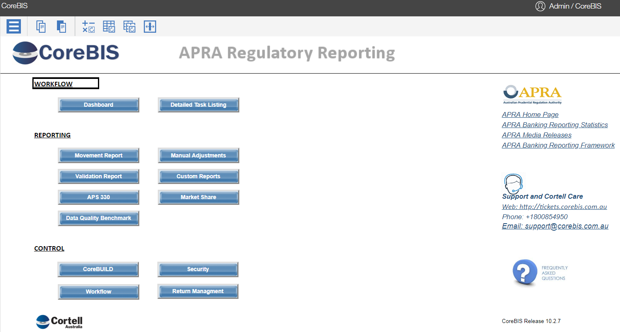
CoreBIS native menu options
2
3
4
5
6
7
1
Actions
Copy
Paste
Recalculate
Rebuild sheet
Rebuild current workbook
Autofit
Notes:
KARL - > rebuild and save
Actions – export and close
Copy
Paste
Recalculate – if you would like the current view refreshed you can select this button
Rebuild
Autofit

Slide 29
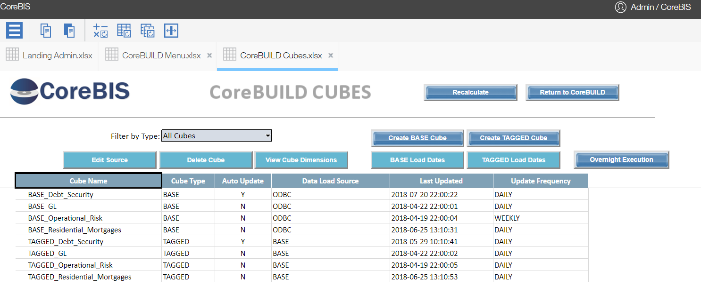
CoreBIS buttons
Dark blue = no context
light blue = context to cell

Slide 30
Delivery Process
SECURITY
Security setup of users
DATA
High level analysis of your data (complete)
Detailed base cube design (complete)
Create business dimensions in CoreBIS (wip)
Create SBR dimensions in CoreBIS (wip)
Create base cubes (wip)
Create tagged cubes (wip)
Tag data (training - BA)
Map data (training - BA)
WORKFLOW
Create period
Assign users to workflow
Notes:
I think we should move into tagging at this point

Slide 31
Period End Process
CoreBIS auto update
Rollover workflow
changes in tagging?
Lock Data Workflow, lock Form workflow
Reporting

Slide 32
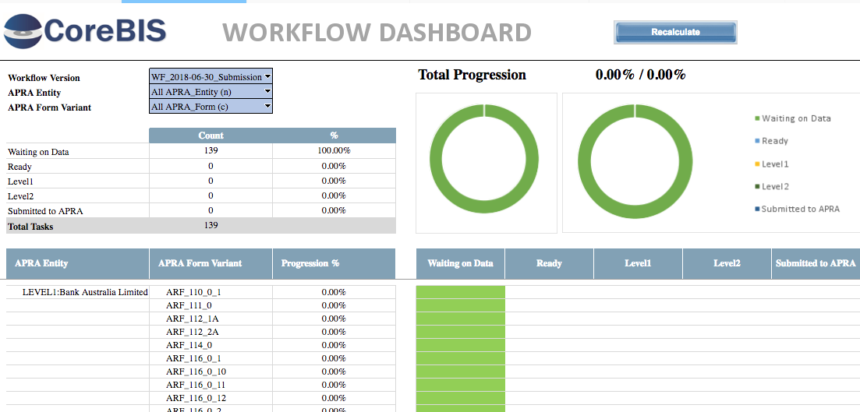
Dashboard
Notes:
Probably revert back to this as they can see if work as we progress
Shows progressions against the tasks for each reporting period
Can filter at the top
Dashboard is contextual to users
Level 1 = Reviewer
Level 2 = Approver
Submit to APRA = Submit to APRA

Slide 33
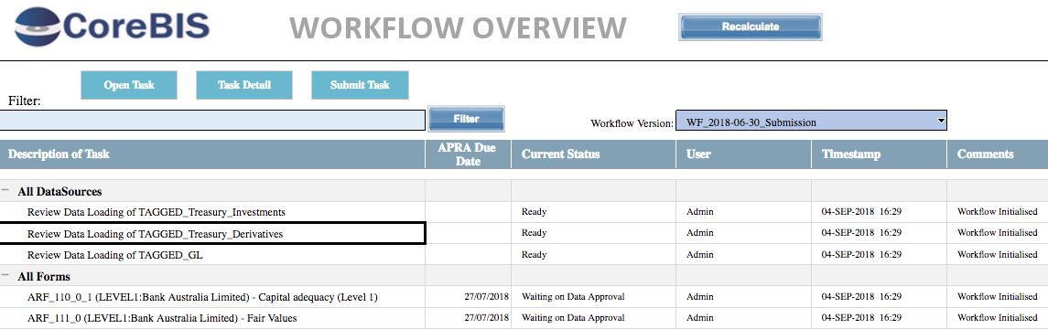
Workflow Task Detail – 2 Separate workflows!
1
2
DataSources WF: this controls approval over the data flowing into CoreBIS, the tagging and the mapping
Form WF: approves manual adjustments made and submission of the Forms
Notes:
Data load logs – when you click on return to landing page it takes you to the general user landing page, this is not a fault, it can only take you here and not to the admin landing page.
You can change the date in the task detail for when you need a task complete

Slide 34
Workflow Task Detail
Note: Workflow version
1
2
3
4
5
6
Tasks descriptions can be defined
APRA Due Date – defined by D2A dates due to APRA. These can be changed manually to create internal timelines
Current status – read, waiting, approved
User – assigned employee
Timestamp – time and date for when the task moved into current status
Comments – status of task
Notes:
Data load logs – when you click on return to landing page it takes you to the general user landing page, this is not a fault, it can only take you here and not to the admin landing page.
You can change the date in the task detail for when you need a task complete
KARL – can you assign a group as a User? Assume could
KARL - > what happens if you type in commentary in column 6, even after recalculate or rebuild the comment stays there, so what happens in normal business process (that is because I am logged in as admin)

Slide 35
Approval Process
Reviewer
Approver
All Data sources need to be approved before you can move into the Form Workflow process.
DATA WORKFLOW
Reviewer
Approver
Submit to APRA
FORM WORKFLOW

Slide 36
DATA WORKFLOW
Rec report
Data logs
Tagging changes
New data
CoreBUILD

Slide 37
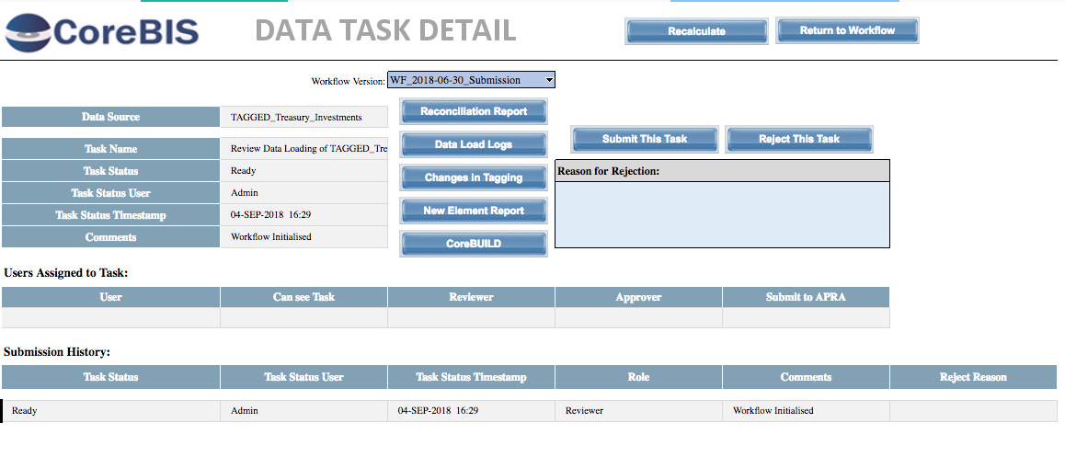
Data Workflow – Task Detail
1
1
1
1
1
Notes:
Task detail provides more specifics about the task, and also provides the same five options for what the Open Task button does. This is different when you move on the Form WF

Slide 38
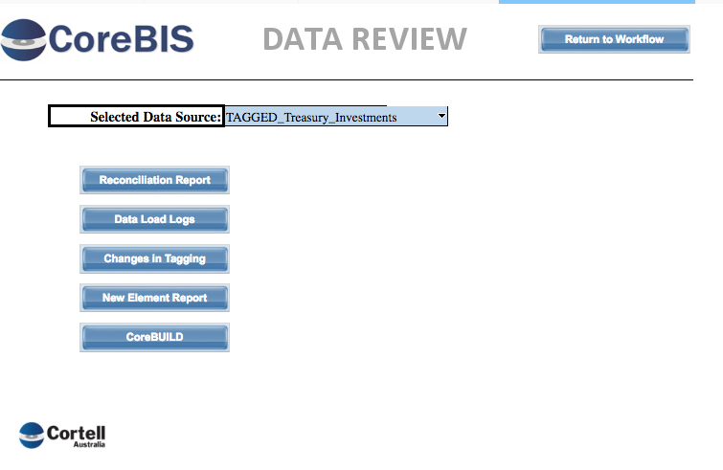
Data Workflow - Open Task
1
Do the transactions that are loaded into Base cubes flow through into tagged cubes?
System logs providing
What has changed in tagging from period to period?
What new data points are in CoreBIS that have not previously been seen?
The control centre for data flows
2
3
4
5
Notes:
Same button options as Open task menu, just a different way to navigate there.

Slide 39
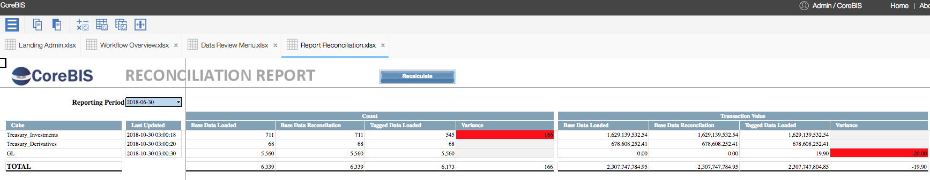
Data Workflow – Reconciliation Report
1
3
4
5
6
7
2
List of the base cubes that are used
Date for when the base cube was last updated
Count of transaction records that are loaded into the base cube
This is the sum transaction record
Count of transaction record loaded from the base cube to the tagged cube
Is there any variance between the base cube and tagged cube loads ie have all transactions flowed through correctly
Same principle but with absolute values used instead of transaction record count
Notes:
KARL – 4?

Slide 40
Data Workflow – Reconciliation Report Variances
Variances identified in the reconciliation report will be driven by:
  New base data points in your data e.g. GL account, cost centre, product code
  No tagging of data
  Deleting of data accidently
  The data review screen is not dependent on the drop down box at the top but how does this relate to security
  Base data load then then data base load and then tagged cube load
Notes:
To action the differences, do you run your base data report and changes in tagging?
You cannot drill on this

Slide 41
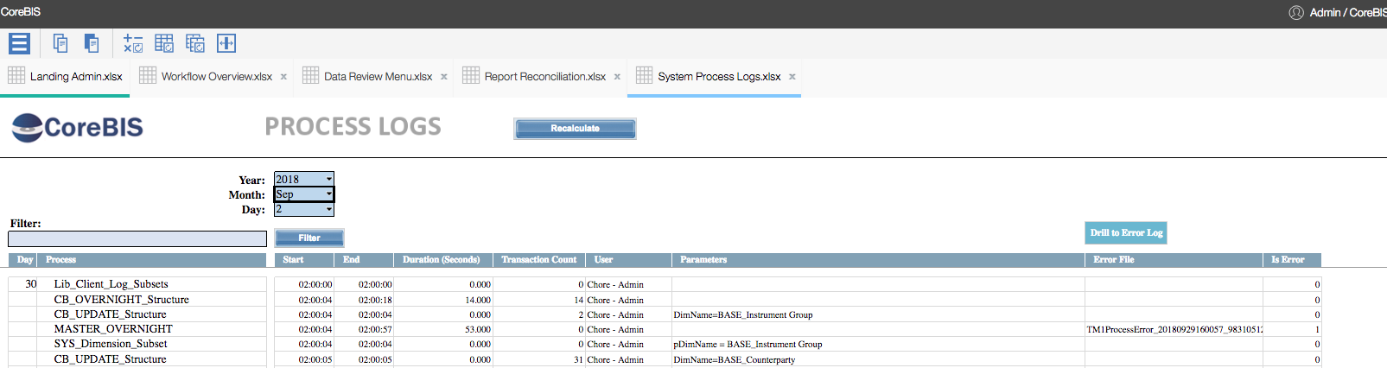
Data Workflow - Data Load Logs
System admin user including Cortell Support Team: support quick identification and resolution of issues

Slide 42
Data Workflow – Data logs – Error log
CoreBIS Support team will use this to identify where errors exist with a view to remediate any system issues
Notes:
Again this is an admin based role

Slide 43
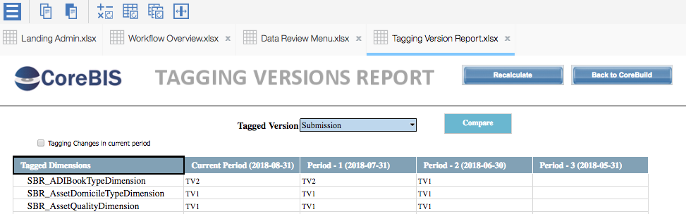
Data Workflow – changes in Tagging
5
1
2
3
4
Zero suppress values that show no change
List of dimensions under review
TV = Tagging version
Comparative periods, lets you identify which dimensions have changed
Allows you to compare the details of tagging versions

Slide 44
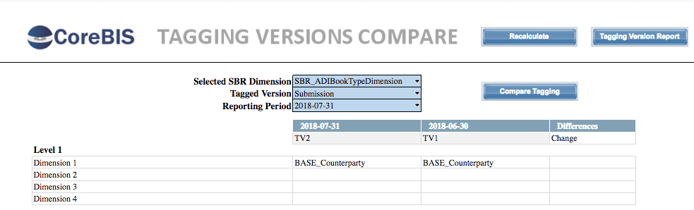
Tagging Version Compare
Even though the same dimension within each tagging version, there has been a delta within the actual members or data points within the dimension, you therefore need to drill further into compare tagging
Notes:
Even though I am drilling through from submission version for period 8, in this screen I have changed the reporting period to compare what the differences where between period 6 and 7 when TV2 was created.
The Base elements in this screen show that they are the same, however you can see there are differences listed which means there has been an actual change in the tagging of the data points (members) themselves. Click on the compare tagging to see where this difference exists

Slide 45
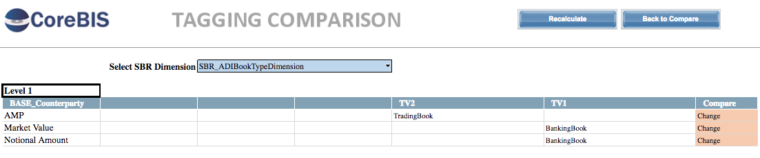
Tagging Comparison Detail
In the example, the Tagging version 2 has changed the base counterparty for AMP to go direct to the trading book, as opposed to the banking book in TV1. This means data that is recognized with a counterparty of AMP will flow through to the Trading book.

Slide 46
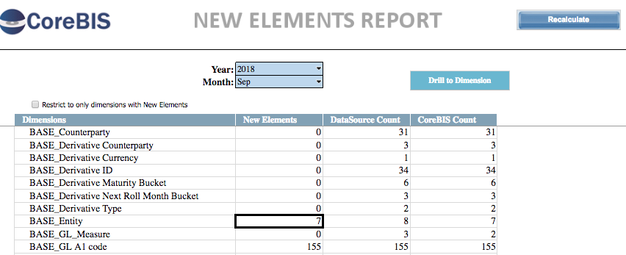
Data Workflow – New Elements Reporting
1
2
3
4
2. New data points (elements) for the period only
3. Total data points coming from source including previous periods
4. Total number data points in CoreBIS, if something is deleted from the data source then there will be a difference
Notes:
KARL -> examples to be provided on data points

Slide 47
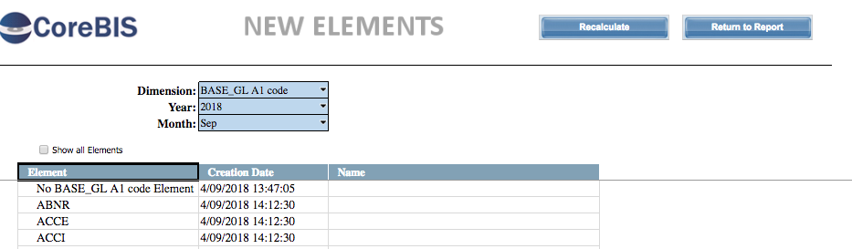
Data Workflow – New Elements Reporting: Drill

Slide 48
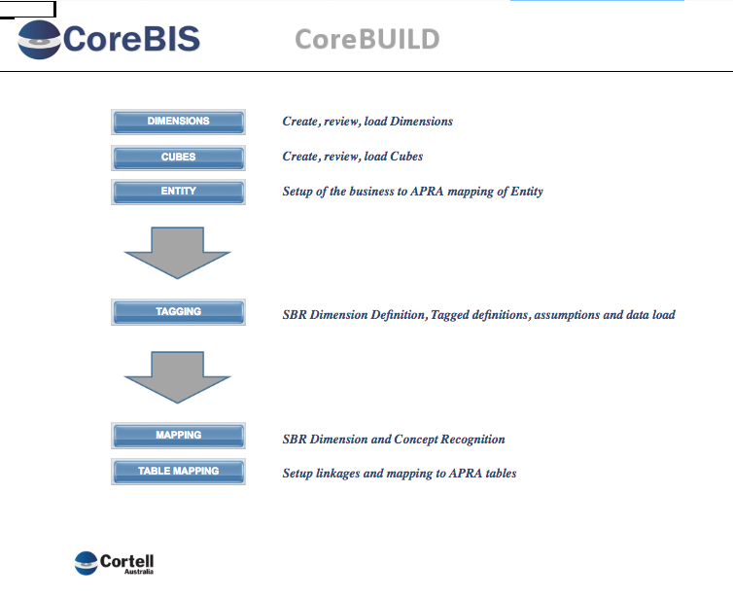
Data Workflow - CoreBUILD
Notes:
Takes you to the main CoreBUILD menu which we will come back to later in the training.

Slide 49
Form Workflow
Open Form
Movement report
Trend report
Manual adjustments
Validation report
You are approving each of these tasks when you select submit on the task allocation

Slide 50
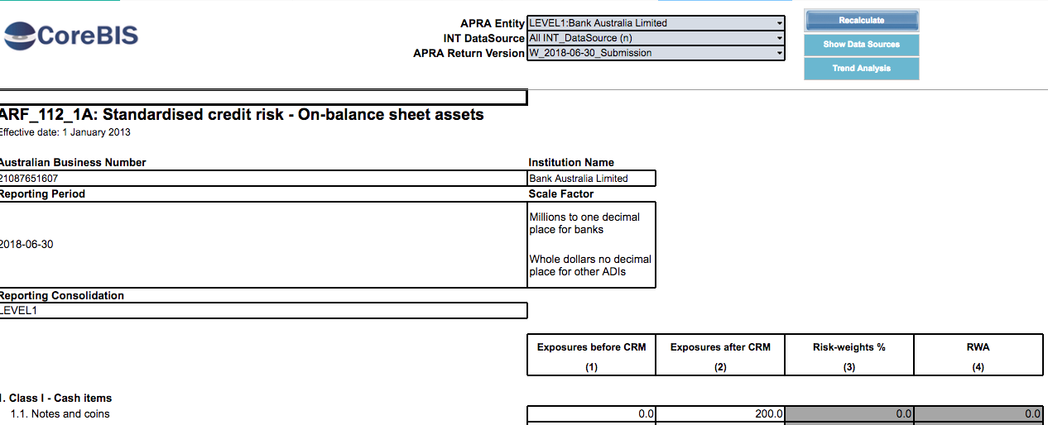
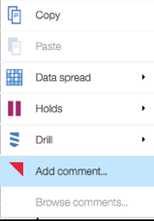
Form Workflow – Open Task
1
Close correlation with Form Variant, but you can have access to run the report at a non APRA level if desired
Int Data Source = data that will be forwarded to APRA. You have flexibility to select individual data sources e.g.:
  Manual adjustment
  Treasury
  Unscaled
Workflow version (check period, submission v resubmission)
2
3
4
4. Adding comments you can right mouse click on the cell and add comment
Notes:
We recommend you use this comments action so that when you complete movement reporting or are assessing your trend lines, you can readily see the cause of material movements in cells

Slide 51
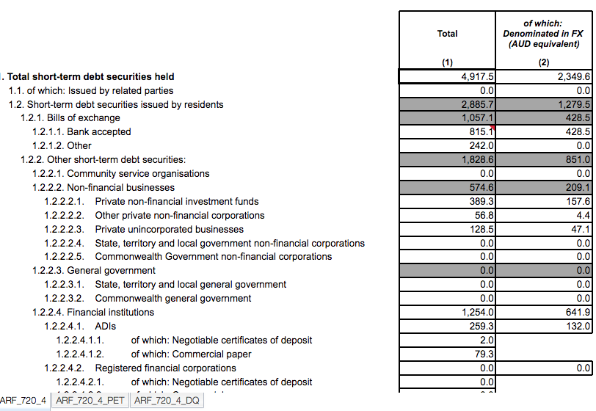
Form PET and Data Quality tabs

Slide 52
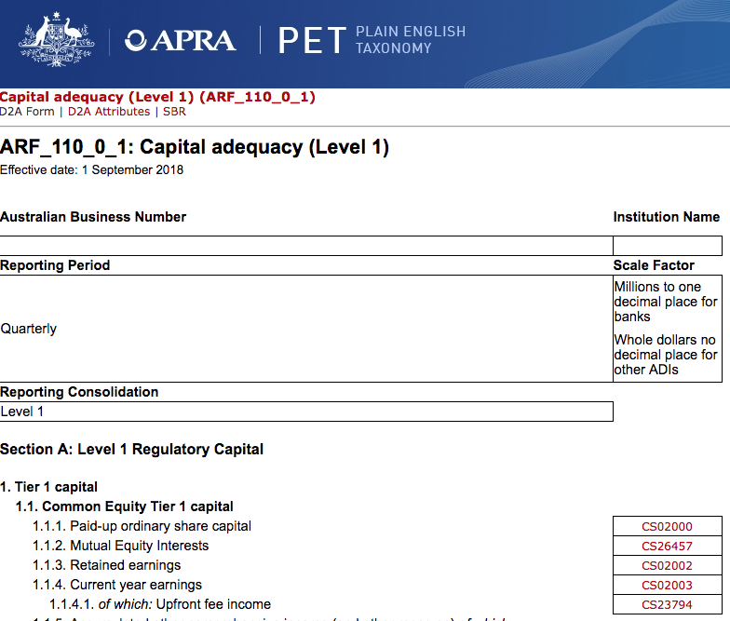
Form PET
At bottom of screen you will note 2 or 3 tabs
Tab 1 – the Form with numbers
Tab 2 - link to APRA PET
Tab 3– if appropriate, EFS data quality benchmarks for the specific form

Slide 53
Form EFS Data Quality Benchmarks
As part of the Economic and Financial Statistic (EFS) reforms, APRA is providing data quality benchmarks that they expect additional assurance over.
The benchmarks are divided into:
  Priority
  High Priority items
The thresholds are dependent on whether the reported metric is a stock (balance), flow (movement) or bps measurement
They are also dependent on the size of the reporting institution

Slide 54
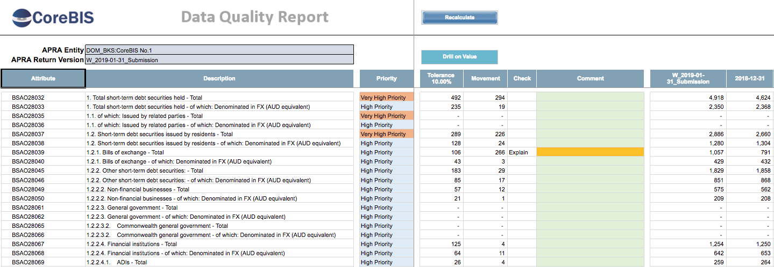
Form EFS Data Quality Benchmark Report
Need to save data first

Slide 55
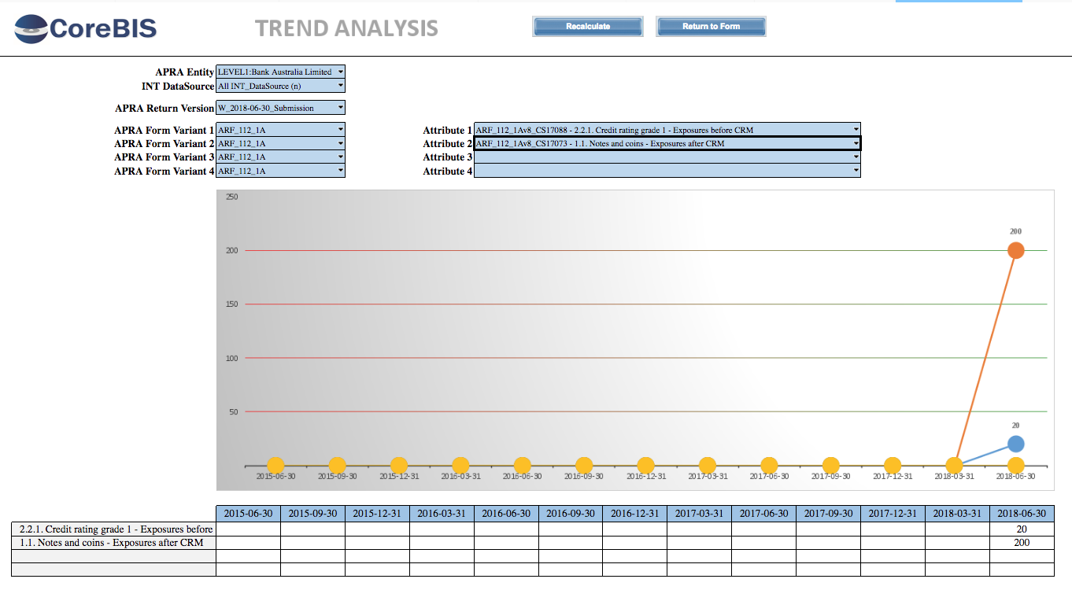
Form Workflow - Trend analysis
1
2
3
Notes:
You can drill on this screen and also add comments to the cells at the bottom of the graph
You can also export for distribution or inclusion in reports
Again you can filter on the int data source etc

Slide 56
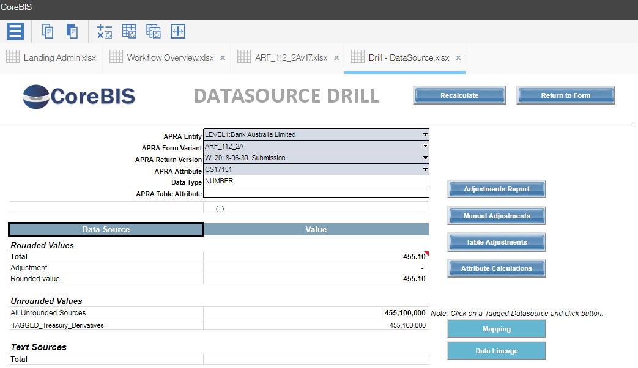
Form Workflow – Data source drill
1. Data sources
2. Absolute values
3. Adjustments made
3
1
2
Notes:
Data lineage button

Slide 57
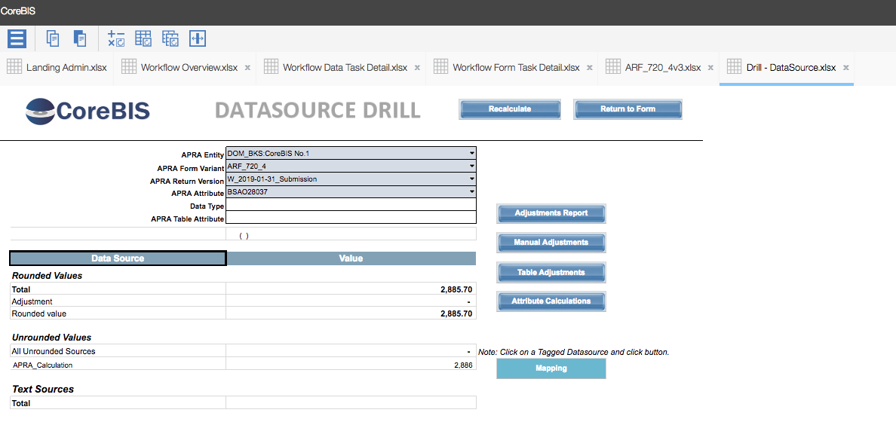
Derivation rules

Slide 58
Drill Down to source data
You can navigate from reported number to underlying source cube (and underlying layer if required)
  Right mouse click
  Drill – Int_Datasource
  Under tagged Data select the cube
  Right mouse click on replace
  Drill – z-module
  This will take you to the cube view to slice and dice
Notes:
KARL -> can you provide the instructions on the drill

Slide 59
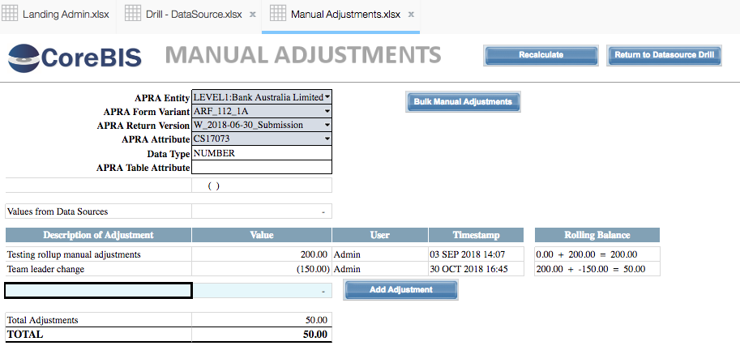
Form Workflow – Manual adjustments
Commentary required
Historic comments
Accretive adjustments
Multiple adjustments
4
2
3
1
Notes:
Remember to click add adjustment

Slide 60
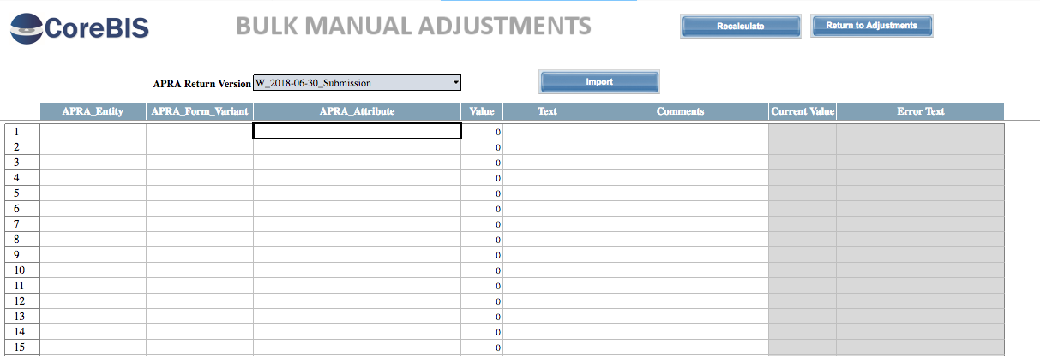
Bulk Adjustments
Notes:
KARL - > there is no validation control on import

Slide 61
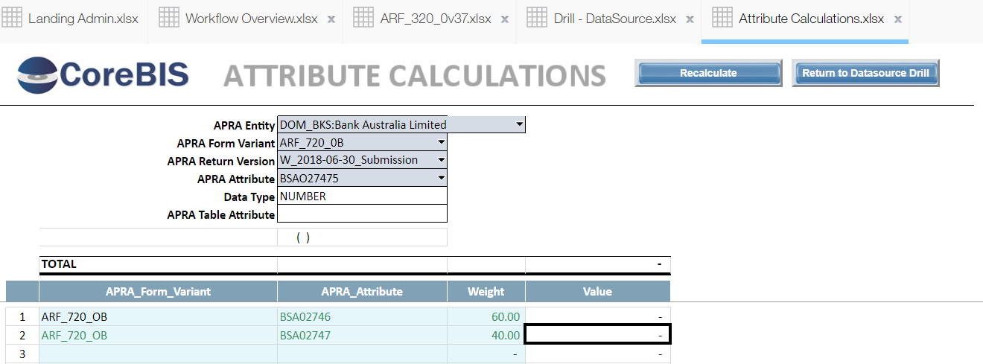
Attribute Calculations
Allocate via % or value, the drop down filters provide the source and the destination location is listed below. The value on attribute calculation is the value coming through from the Form. Applying a -1 will apply a subtraction to the calculation.
Notes:
Value on attribute calculation is the value coming through from the form
Weighting is 1 or -1 (for subtraction)

Slide 62
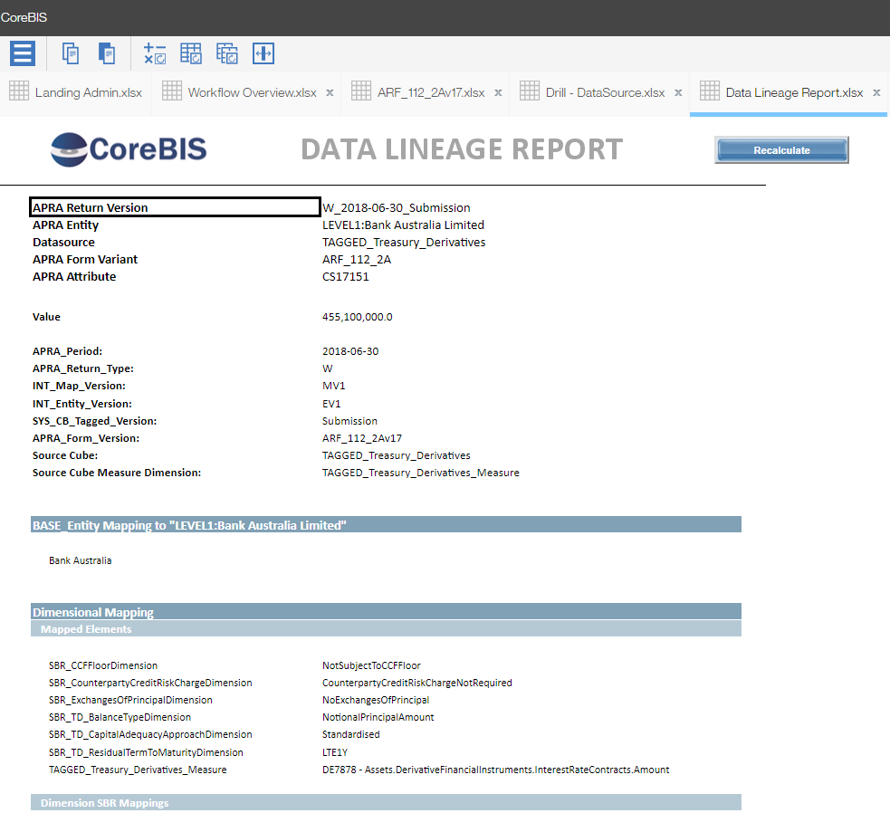
Data Lineage Report
Trace all data inputs that feed directly into the reporting amount against each attribute

Slide 63
Movement Reporting
Delta analysis
Absolute and % variances
  Tolerances at top of screen
  Conditional formatting
Only attributes with values shown
Current workflow version is defaulted
Movement reports cannot be locked, therefore for audit purposes we suggest export and save to your monthly directory

Slide 64
Movement Reporting – scenario’s
period on period delta
Change the % and absolute value at top
resubmission version v submitted version
Data source change
Completing commentary:
  open trend line report on separate tab
  change attribute you are looking at, review comments in cells
Save down PDF for movement report completion
What happens when a Form changes?
Can I run a movement report against non APRA consolidated entities?
Notes:
KARL - > last question re entity structure

Slide 65
Manual Adjustments
Only changes that can be made post data workflow lockdown
Changes made via attributes
Only attributes with values shown
Manual adjustments added at the lowest level do not rollup into the higher level ie you need to add them in again

Slide 66
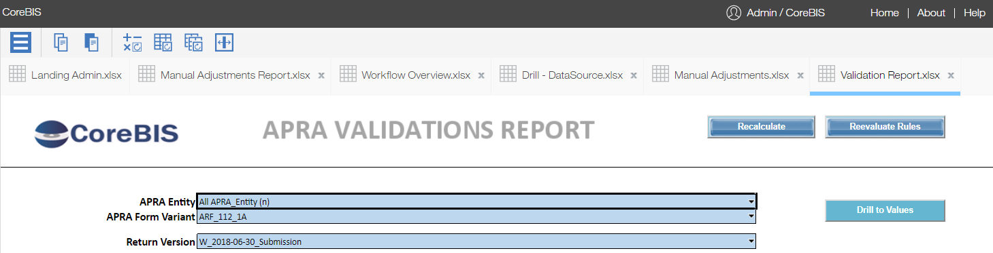
Validation Reporting
Notes:
Validations - what does reevaluate rules button mean/do? Validations are not real time due to the formula evaluation nature, so you can hit that button to re-evaluate the rules against the $. This also occurs overnight.
Reevaluate rules when you make adjustments so it will check the rules again

Slide 67
Validation Reporting – Drill to values
Conformance v mandatory rules
This provides what APRA has supplied with:
  plain English explanation of the rule
  mathematical rule
From here you can drill to underlying positions

Slide 68
Custom Reporting
Perspectives training to be provided upon installation

Slide 69
APS330
Each of the reports will appear on the APS 330 landing page
We can segment into Qtrly or annual if desired

Slide 70
Market Share
These reports combine your business data with industry published statistics to give you insight as to your market share against those reporting items
The reports are updated 1-2 months in arrears, depending on when APRA release the statistics
Filters can be used to refine comparisons

Slide 71
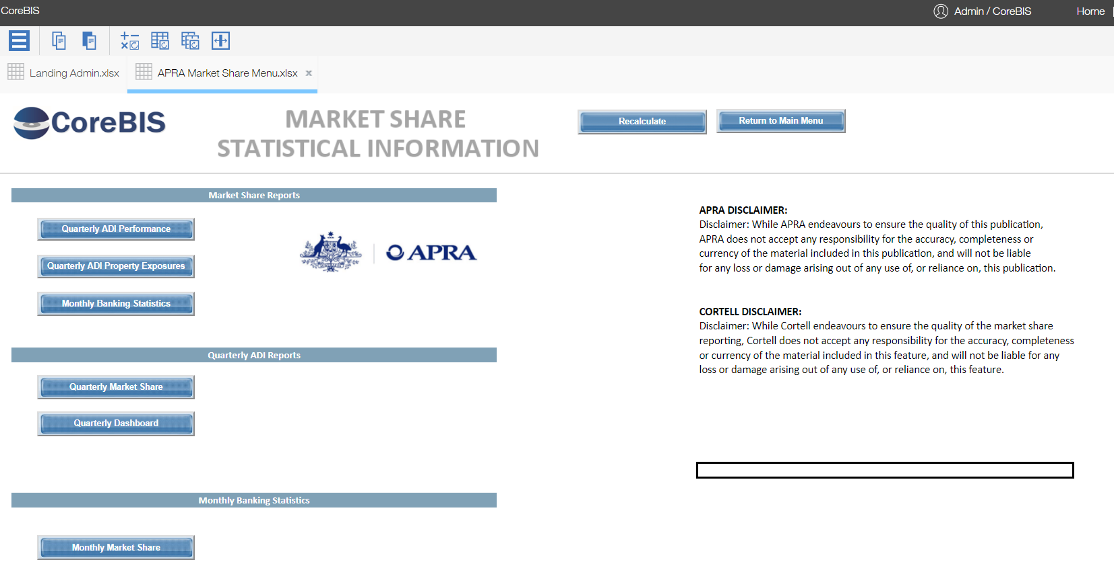
Market Share
Industry published statistics
Quarterly market share
Monthly market share
1
2
3

Slide 72
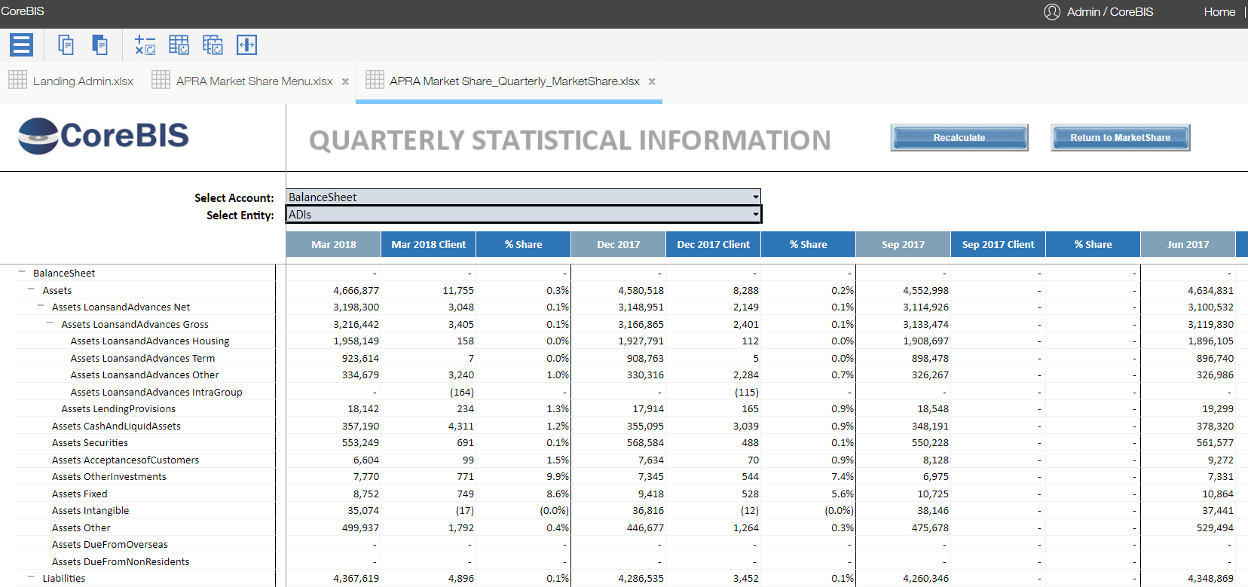
Market Share
Raw Statistics

Slide 73
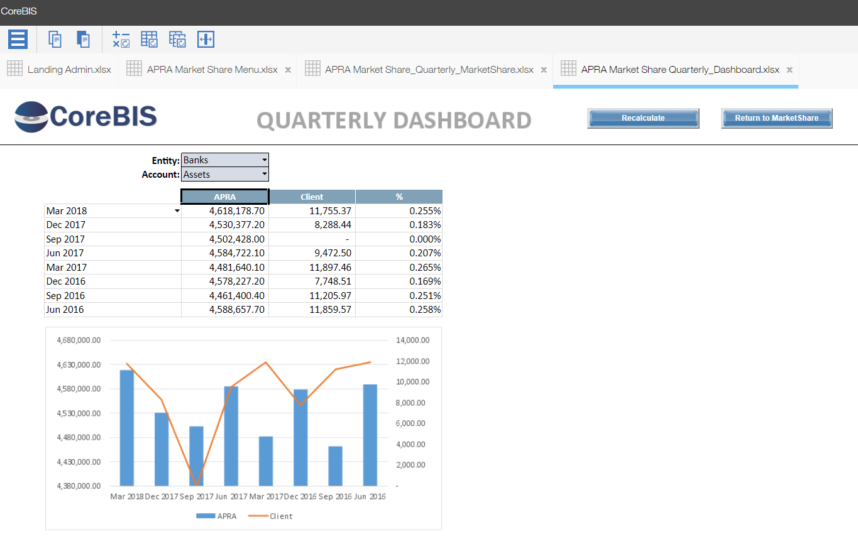
Market Share
Raw Market movements in reported data

Slide 74
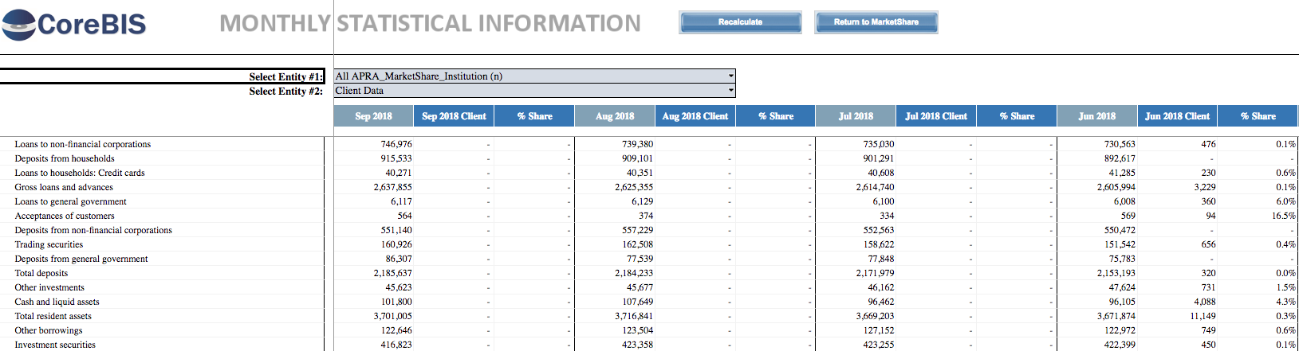

Monthly market share - summary
1
Compare your data against the industry or against individual institutions

Slide 75
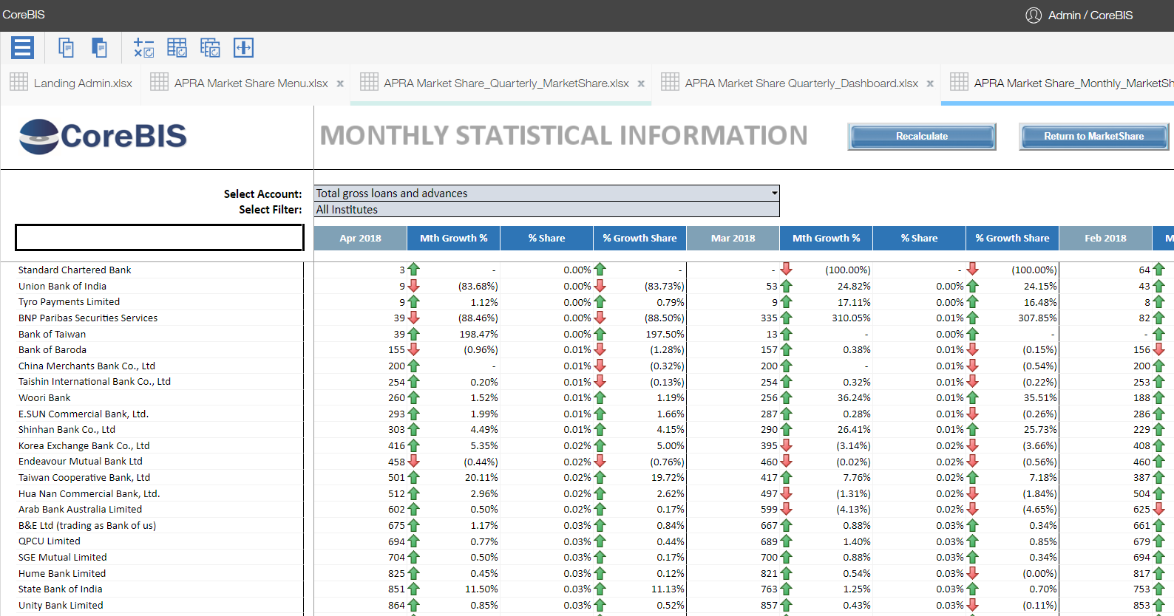
Monthly Industry Statistics – by Account
1. The filters e.g. top 10 are the top ten institutions for the selected value
1

Slide 76
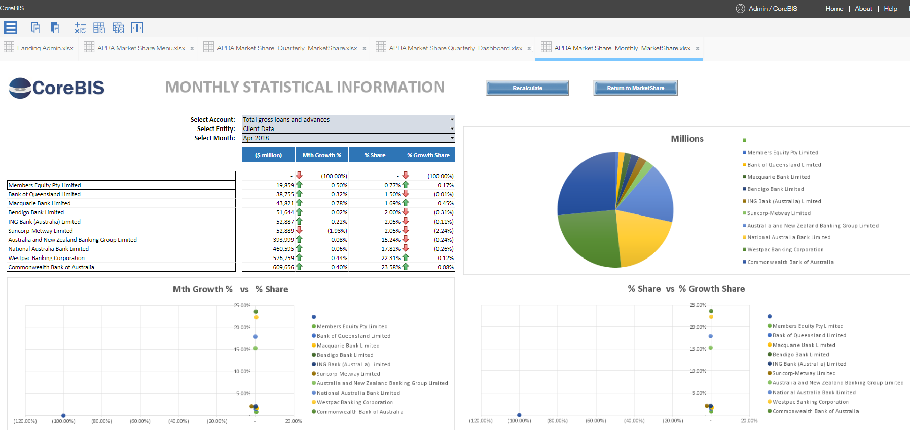
Monthly Industry Statistics – Graph

Slide 77
Data Quality Benchmark
RBA / ABS driven: quantitative thresholds applied
This report provides snapshot of all reporting data points that attract data quality benchmarks including historic trends and threshold calculations
Can be filtered to specific forms

Slide 78
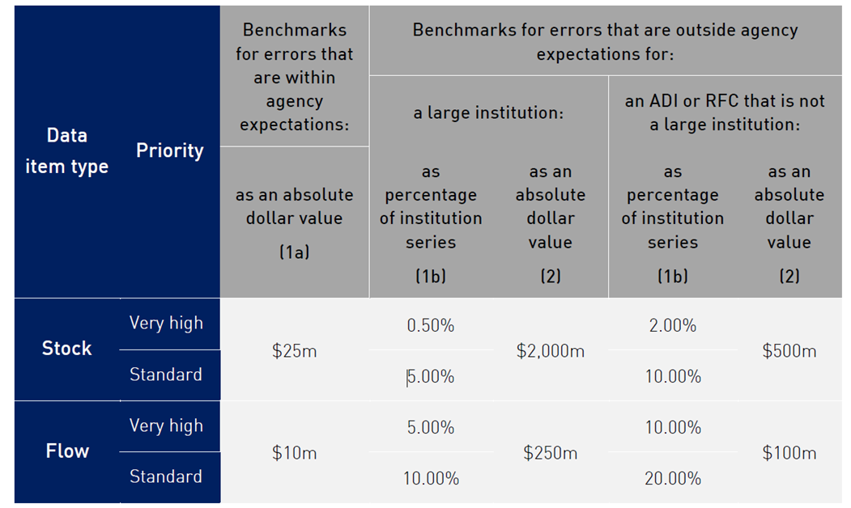
Data Quality Benchmark
<$25m ignore
<$10m ignore
Stock - Very high 2%
Stock - Standard 10%
Flow -Very high 10%
Flow – Standard 20%
3
1
4
5
2
6

Slide 79
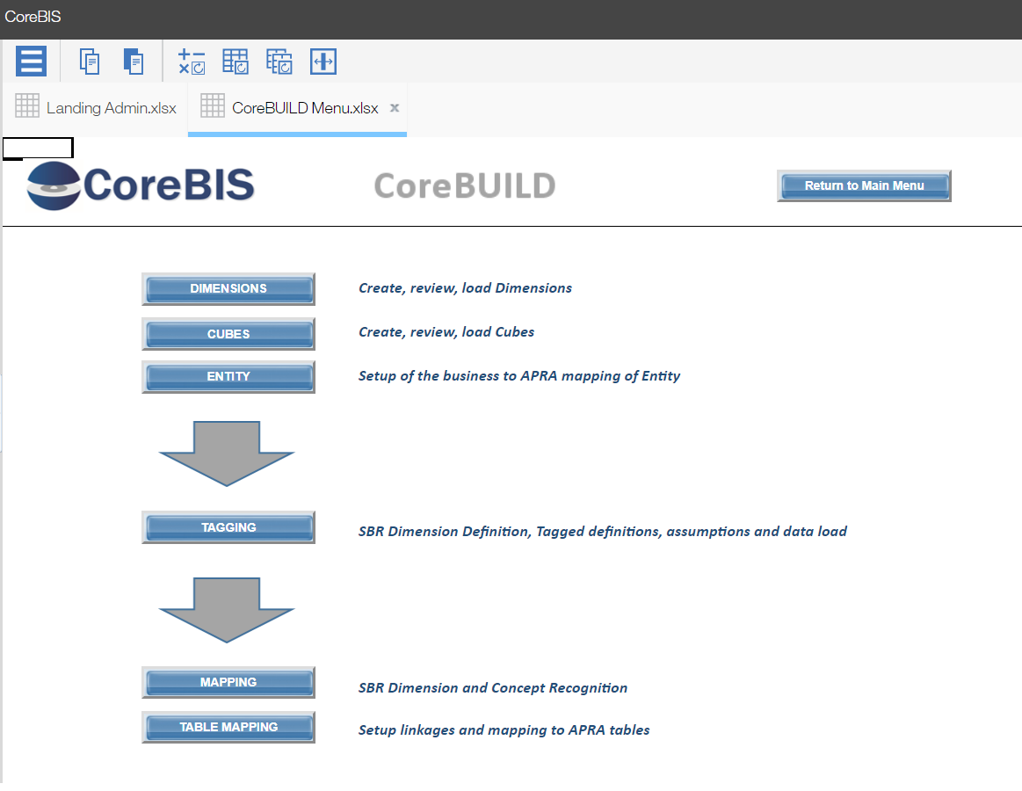
CoreBUILD
CoreBUILD is the key building block engine that controls how data:
1. loads into CoreBIS; and
2. flows through CoreBIS
CoreBUILD controls version integrity of:
Source data
Tagged data
Mapped data

Slide 80
CoreBUILD Process Flow
Business Dimensions
SBR dimensions
Base cubes
SBR cubes
name
populate
Identify and name
tag
name
populate
name
populate

Slide 81
Business or Base Dimensions
1. What dimensions (fields) do you want to report?
  eg GL accounts : we want to bring all GL accounts into CoreBIS
2. How do you want to identify or tell CoreBIS what the GL accounts are ie how does CoreBIS know what the COA is?
  automatic updates from source/DW
  manually list them
  Text file
  Custom process
THESE CREATE BUILDING BLOCKS FOR YOUR TAGGING
Notes:
This is where the new data elements report comes into play

Slide 82
SBR Dimensions
These are the dimensions that you use to report to APRA
They are what’s found in the PET
They are comprised of members (these are lists of possible data points)
When you create an SBR dimension, you will automatically see the list of members in CoreBIS.
Notes:
Refer to PET here to support the explanation, then go into create an SBR dimension where you can see the list of all possible elements

Slide 83
Tagging
Process of joining multiple business data fields together to equal one singular data point for reporting to APRA
e.g.
A + B + C = Tag
T = SBR data point

Slide 84
Create Base Cube
Combine business dimensions together into logical subject matter
Add a measure to the cube so it has meaning
Tell CoreBIS how you would like to populate the cube?
  Automatically or manually initiate CoreBIS to update the base cube

Slide 85
Create Tagged Cube
Which base cube are we going to use to create the tagged cube?
What SBR dimensions are we going to add to the base cube?
How are we going to load data into the Tagged cube?
  We have data flowing into the base cube
  We have setup tagging so the system knows where to put data to
  Select your base cube to populate from

Slide 86

Dimensions

Slide 87
Dimensions
Dimensions are lists of related members
Two or more dimensions make up a cube
Most cubes will have a ‘Measure Dimension which are the measures you would like to report on e.g. YTD balance or number of home loans
Notes:
NOTE: Measures dimensions are created within the Cube creation screen. The process supporting the creation is automated once you select your name and type.
NOTE: you cannot delete a dimension that has already been used in a cube. You can delete a dimension if it is yet to be used.

Slide 88
Business v SBR Dimensions
Business Dimensions
These are your source data dimensions that we will create with you within a logical data model. Example business dimensions include:
General ledger account
Product type
Counterparty location
Currency
SBR Dimensions
SBR dimensions are provided by APRA. The SBR dimensions contain pre-defined elements or lists of data points that make up the SBR dimension. These data points are combined with your business dimensions to create the “tagged” data point that is reported to APRA.
Notes:
Filter on the type of dimensions
What does overnight execution mean
What is the difference between a dimension update and a cube update?

Slide 89

Creating a business dimension
Select type of dimension
Enter name
Click Create Dimension
Select update from
Auto update
Click on “Edit Source” to complete the update details for the new dimension.
Updated automatically
Completed within the edit source screen (i.e. next screen)
Only used when you need to manually update the auto
1
2
9
6
3
7
5
8
4
Notes:
NOTE: A business dimension automatically adds the naming convention of BASE before the dimension (facilitate understanding for end users)
Talk about two types of dimension being Business and SBR. We will go through an create a business dimension first and run you through the means for updating the dimension.
What you need:
Dimension Type: Here we are going to create a business dimension, note once you select Business Dimension the SBR dimension reverts to N/A
Enter the name of your business dimension NOTE: Base will automatically be added as a prefix to your dimension name. This facilitates ease of understanding
Click button
Scroll to the dimension list and you will see you new Dimension has been created (n.b you will be searching for a dimension with prefix ‘Base’). Select your new dimension and then indicate where the dimension is updated from (by selecting drop down menu). NOTE this drives the next screen you will see, be it a screen for ODBC, Manual input, text or custom.
Update auto update column with drop down, this indicates whether you need to manually update this or not for reporting period end. (NOTE, for manual updates, no drop down appears as manual by definition cannot be automatically updated.)
Edit source to provide the details for how the dimension will be updated.
Automatically populated. NOTE: this gives you the last update only, if you did want to see historic updates you can revert to the process logs (refer to Process logs section)
Update frequency gives you more transparency and control over when you would like the dimension updated. It is updated from the next screen
This will update all those dimensions that are set to “Y” with the appropriate date ie the automatic updates. This will happen automatically, ie you do not need to select this button to run these processes. It is presented here as an button to select if ever the process did need to happen manually eg if a cube was to crash and you need to manually “re-run” this process, you can click on this button and it will run the processes.
This section is only about creating dimensions - > highlight this section to the right (even colour code for future)
.

Slide 90
Dimension Element updates
Dimensional elements can be updated via one of 4 means:
  1. ODBC
  Connection to an external database
  2. Text file
  Generally a file generated out of source system or third party application
  3. Manual
  Allows the individual input of dimensional elements or bulk upload
  4. Custom process
  Leveraging the Tubor integrator (TI) ETL tool within CoreBIS
Notes:
Note: dimension updates supplement existing dimensions, they do not replace.

Slide 91

1. ODBC connections
Click on cell and drop down will indicate whether the data source name (DSN) has been created within CoreBIS.
If no connection established select “Create new ODBC”
Automatic
Defined by dropdown
Commencement date (only runs prospectively)
Preview the new dimension for accuracy
1
2
6
3
4
5
Notes:
This is a connection to a external database. If the ODBC source has not been created within CoreBIS you must first create this source.
KARL - > How to change an SQL statement
KARL -> What happens to history when you do change a statement?
5. If you would like to backdate a data load then this can be done through the Support team.

Slide 92

Preview ODBC Connection
Notes:
Preview allows you to ensure the structure of the data feed is correct.
Update will physically update the dimension.
Karl - > when I click on Preview from this screen it tries to run the process when the process has already been ran to generate this screen. Should the button perhaps not have a “Return to CoreBUILD” instead?
Karl - > Does the update run the same process as overnight execution?

Slide 93

New ODBC connection
1
2
3
Provides list of available system DSN’s for use by CoreBIS
User name credentials to gain access to the ODBC
Password required to access the nominates DSN (NOTE: not required for integrated login)
Notes:
NOTE - > CoreBIS will not create an ODBC itself, it only references established connections (DSN’s). You need to create the System DSN manually and then reference it (the new ODBC name needs to be the same as the system DSN).

Slide 94

2. Dimension Update - Text File
Specify file location (NOTE if no file folder is specified it will revert to the default created upon setup)
Specify your file name
Automatically updated
Stipulate via the drop down how often you would like this file to be updated into CoreBIS
Select calendar icon and nominate the date for which you would like this to start
1
2
3
4
5
Notes:
If you would like to update your dimensions via a text file upload then this offers the functionality.
This screen acts as a pointer to where the text file can be found and the frequency for which you would like to update the text file (if for example the dimensions were to change each month then this could be a monthly update).
For the most part dimensions will not be updating
NOTE: The text file needs to be in a pre-specified format which can be seen in the next screen

Slide 95

2. Preview updated Text dimension
Parsed from prior screen
Default
Automatically created NOTE: record number does not need to be part of the source file, this is created automatically by CoreBIS
Element reference e.g. 55465 (for GL account number)
Element Name e.g. staff salaries
1
2
3
4
5
Notes:
The format of the file needs to be in a prescribed layout as detailed above.
NOTE: record number not required in source file
KARL - > confirm record number if not required in source file

Slide 96

3. Dimension update: Manual update
4
1
3
2
Update the element reference
Element name
Data type of element being Numeric or Text
Note there is no preview button for manual updates given it is representative of what you see in the dimension already
Notes:
ADD in the remove element comments.
Also note this screen does not bring back all elements within the cube, you need to go to the subset editor on previous screen. KB is considering updating this.
Be sure to select update dimension!!

Slide 97

3. Dimension update: Manual update
NOTE: there is no
preview button for manual updates given it is representative of what you see in the dimension already
4
1
2
3
Update the element reference
Element name
Data type of element being Numeric or Text
This screen provides a mechanism to update elements, however if you would like to see a list of all elements already within the dimension then this button provides this option
Notes:
ADD in the remove element comments.
Also note this screen does not bring back all elements within the cube, you need to go to the subset editor on previous screen. KB is considering updating this.

Slide 98

4. Dimension Update – Custom Process
These custom processes will be developed the administrators of the system (be it Cortell or Client).

Slide 99

Preview Custom Process
Notes:
Karl - > Is it worth having a preview button in here as well?

Slide 100

Creating an SBR Dimension
Notes:
Creating an SBR Dimension can be a one for one with the APRA taxonomy or you can create your own specific SBR dimensions that cater for your logical data model.
The SBR dimensions will automatically be populated from the SBR framework
Unfortunately the SBR framework does have some deficiencies in which we need to override these deficiencies through CoreBUILD, and that is why we give the capability or flexibility to create Business SBR dimensions for clients to cater for those instances where the dimensional build up from APRA is not great.
CoreBUILD Dimension creation: Select SBR dimension is not a subset and hence cannot filter on the search – is there any approach to this?

Slide 101

Creating an SBR Dimension
Notes:
Whilst we use the APRA SBR dimensions, you still are required to create your company own SBR dimensions. What does this mean?
You may have dimensions that are tagged differently within your data hierarchy, you may require dimensions across different cubes to be used to service different reporting requirements eg commitments definitions. SO to address this, you create your own SBR dimensions, and the(se) dimensions are correlated to an SBR dimension, which then pulls in the elemets from the dimension, and you can tag to this. It provides ultimate flexibility.
You need to establish SBR at the front of the dimension name (you can copy and paste from the cell above). We also advise naming your SBR dimension with the name of the cube.

Slide 102
System Dimensions
There are 4 system generated dimensions:
BASE_Cube_Load_Date
Keeps track of individual data loads to the individual base cube
Reporting_Period
Driven by the APRA reporting period
BASE_Entity
correlates to the banks entity structure
SYS_CB_Tagged_Version
submission, resubmission version control (controlled via workflow)
Notes:
You need to update the SBR tagged measure (which is created upon creation of the cube) with the relevant data fields. The best way to do this is to update manually, then copy paste from the excel workbook which will have the data contained within.

Slide 103

Cubes

Slide 104
Entity

Slide 105
Types of Cubes
A cube is a collection of 2 or more dimensions and a measure
Within CoreBIS there are 2 primary types of cube you will be using:
  Base cube – containing your business data
  Tagged cube – containing base cube data joined to SBR

Slide 106

Cubes
1
6
2
4
3
5
Notes:
Explain each of the columns
4 – you will note there is no manual update process, this can be done through manual adjustments if need be.

Slide 107
Cubes
Notes:
We are going to step through the creation process

Slide 108

Create a new Base Cube
1
3
2
Cube name is generally attached to subject matter area of the data
Dimensions that have been created will be provided in a drop down list for the user to select from
See next screen
Notes:
When you click on create cube (base), you will note that the cube has three dimensions automatically added. This is a CoreBIS control function that ensures all cubes have the same first three dimensions.
If you click on create cube this kicks off the process to create a measure, hence you should always add your dimensions in first, then you measure and then click create cube
If you go to edit source and there is no ODBC, manual or text update field entered nothing happens ie you need to identify the update source first

Slide 109


Creating a measure
You do not enter your measure details in the dimension screen, the measure will be automatically created
Notes:
Type an element name
Type your data type.
Measures are created when you type in the name of our element e.g. Account balance, and the type (numeric or text). When you select create cube the measures are automatically added to the list of dimensions under the dimension type “Measures” (every cube needs a measure). Think through example of measure being value, with the $ amount being value.
Note: the actual creation of the measure occurs through automatic process once you select create cube. The dimensional measure will then appear in the list of dimensions under the Dimension type “Measures”. Measures are created per cube.

Slide 110

Edit Source on Base Cube
Notes:
Takes you to the loading of the base cube
KB - > going to provide the blurb on the SQL
The preview button will give you a snapshot of the data for the current period

Slide 111

Preview of Base Cube
Notes:
The Preview data button here allows you to change the APRA period so you can preview data from different periods, it provides flexibility.

Slide 112

Base Cubes – load details
Notes:
This screen allows you to see when your data has been loaded historically against the nominated base cube. The used by tagging indicates whether the data has been pulled through into the tagged cube itself.
If you accidentally load data more than once, you can select the Action Drop down and select remove then apply action to delete the data that was loaded

Slide 113

Create new Tagged Cube
1
2
3
Notes:
You will note it references the base cube that you will be tagging, this needs to be selected in the first instance and then we are going to apply the SBR dimensions over the top. Ie the SBR dimensions are what we are adding to the Base cube to create the tagged cube.
Select your SBR dimensions to use for tagging
You will note the measure is created automatically. It creates a “tagged” measure which is different to the base measure. The Tagged measure creation is then added automatically to the list of dimensions you see (in Dimensions)
-> You can copy paste these in from excel to save time

Slide 114
Tagged Cube – auto update
A Tagged cube can be automatically updated if the associated base cube is automatically updated, simply by clicking “Y”

Slide 115

Data load for Tagged Cube
1
1. you need to remember to reload the data against a resubmission version when you prepare the resubmission
Notes:
Takes you to the loading of the tagged cube (which is the base cube)
I had the issue of the tagged cube not loading after I have deleted some of my base data loads. If you delete the last data load it only reads from this when it tries to update the tagged cube, therefore you might need to reload the base cube again and then load the tagged cube.

Slide 116

Tagged Load Detail
Notes:
Tagged version, if we create a new workflow version e.g. resubmission, does the data load then update against resubmission and present itself here ie so there could possibly be one load date with two tagged versions?
Create working example of this.

Slide 117
Entity

Slide 118
Entity Data makeup
You always need an entity cube which all the other cubes read from. The entity mapping button in CoreBUILD correlates the business related entities to that used by APRA.
You do not necessarily need to bring in all the business related entity data if the consolidation contains it.
There is no lock save and copy function, this is controlled through the data workflow
This means when first setting up, you need to create the workflow first

Slide 119

Entities
Level 1, 2, 3
SPV
Group books
Solo books
(Statutory?)
Notes:
Logically the entity composition will remain relatively consistent for the majority of periods (unless acquisition or ELE changes, or capital relief trust)
Top half gives overview of periods (note the use of EV instead of TV)
Bottom half gives overview of inclusions for those periods
You will note there is no save, lock and edit buttons on this screen, it is not required, when any data source is locked the EV will be locked across all the data sources.
Note: On the Drop down, when tagging the entity version ie when you select whether the entity is in the APRA group, there is no drop down option for “No”, so it is either Yes or blank.
-> NOTE in the first instance when creating an entity version (EV1) you need to ensure there is a workflow created, Post first time then you can copy from previous versions

Slide 120
Tagging

Slide 121

Tagging
What combination of Base dimensions and base elements are we going to use to create the data point to tag to?
Choice of Level 1, 2 and 3, with a combination of dimensions within each
1
1
Notes:
Assumptions relate to the levels effectively.
Level 1 – the most granular level you can tag your data eg. GL account and product. This permits you to tag data to specific requirements
Level 2 – once level 1 has been addressed, Level 2 provides a higher level of tagging, e.g. if GL account and product is not met within the first instance then the system will move to level 2
e.g. domicile eg
Level 3 – overarching assumption where anything is not tagged
Karl -> Confirm: When creating a new version, by default it always copies over from the previous version (albeit I am not sure how sometimes it appears to miss a version (TV1 – Tv3)
KARL - > we should add a button on this screen for return to dimensions (if you navigate here from Dimension creation you cannot return to that screen)

Slide 122

Create new version
Deletes working version
Version status, locked no changes can be made
TV history
Current TV being looked / worked with
Dimensional levels
Correlates to tagged version
This creates the actual tagging
7
4
5
3
1
6
NOTE: Save lock and copy locks the assumptions which are the levels
2
8
Notes:
Save Lock and Copy will copy from the assumptions you have used previously ie the levels remain the same. The levels are not really hierarchical, they present a order for which you can create deviations to tag, and other or all
Think one exception in a gl hierarchy, eg you may want to tag one account as a liability which sits as an asset account
Reset version undoes the save, lock and copy ie it reverses the assumptions that have been locked.
If you click Create new version and then change a

Slide 123

Create new Tagging Version
2
1
Notes:
You have to save lock and copy the version before you commence tagging process

Slide 124

Tagging (from bullet point 8 previous slide)
1
8
2
3
9
7
4
5
6
Notes:
The dimension to be tagged
TV
Level 1, 2, or 3
The list of business elements that are attached to the dimension
If multiple dimensions where being used to create a tag then columns 2 to 4 could contain values
The SBR elements within the dimension (in this instance SBR Counterparty Domicile) for which you will marry up your business dimensions to create the SBR dimensional element
These drops downs allow you to add elements that have previously not been tagged. The list (under point 4) will provide all those elements that have previously been tagged. The option 7 allows you to add new ones should a new element arise.
This allows you to add the item chosen in point 7 to the table below to be tagged.
This gives you all new elements added to the cube that need to be tagged
NOTE: when you are happy with the tagging, select recalculate and the text under element goes from Green to black
NOTE: if you leave an element empty in this tagging process then it will go to no element mapping ie no problems
NOTE: where there is a one for one correlation of data, then you can place the base client dimension member to the measure
Karl - > What is the difference between the “Add all items and Add Selected item” buttons?

Slide 125

Save a new version
Notes:
Karl -> chicken and egg? How do we add items and then click add all items and the above message appears?

Slide 126
Tagging
Level 1 = lowest level of data that can be tagged. This represents individual data points within a dimension e.g. GL accounts within the GL hierarchy.
Level 2 = Support an other or all event e.g. you may need to tag a GL account held in assets as a liability
Level 3 = same as level 2 just the next level up

Slide 127

Tagging versions report
1
3
2
4
Notes:
Tagging versions are created against individual SBR dimensions, so in the above you can see Counterparty domocile is up to the 3rd version of tagging, yet Counterparty type is is only at version 2.
So you can see from this report what versions where used in the final submission to APRA. However if you would like to compare the detail of these versions then you can select compare (2)

Slide 128

Tagging
Notes:
You can use multiple dimensions of your base data to create the “tag”. This creates a concatenated fact to then tag.
NOTE - > After updating any tagging you need to reload the tagging cube

Slide 129

Tagging Versions Compare
Notes:
This screen gives you what business dimensions have been used for the purposes of tagging against the SBR dimension. In this example the asset impairment value type.

Slide 130

Tagging comparison
Notes:
You can see changes highlighted on the right hand side, in this instance there has been a fundamental change

Slide 131
If you add the measure as a dimension and not as the concept, you need to ensure you add the actual measure itself from the list of members eg in the 320 we mapped direct to concept
So if there are multiple options for the measure eg reverse, end of period, opening period balance (and not just the measure as a concept) then you need to check the inclusion of the element within the measure.
Add in the reversing entry re system (from the DB)
Once you have entered a name in the elements, then do not change the name
Always remember to load the tagged cube data after tagging. The measures are not needed

Slide 132
Mapping
Notes:
It is easiest to map to concept by concept.
Select your data source, and then select the concept, this will tell which attributes the concept is used for. You can then type in the Tref ID (which is the concept ID) against the attributes as to where this concept will be used.
What is mapping
Automated mapping v manual mapping (when you need to map?)
Table mapping v attribute mapping
Table mapping is unique in that there are variables in each line presentation. There are multiple rows of data (bring up an example of table). Thje reason fo rthe difference in process is attribute is one for one because the tag has been created. Table mapping has “unlimited” combinations of data to be used in the tagging and reporting process.
Changes in mapping, version control
Mapping by Form v Mapping by concept (when to use, when not to use)

Slide 133

Updating SBR Measure
Notes:
You need to update the Tagged GL Measure with the appropriate concepts prior to being able to map. The easiest way to do this is a manual update and copy paste from the excel logical models

Slide 134

Copy paste manual update
Notes:
Copy and paste the concepts into the Form (we should have had these identified in the first instance from the logical data model)

Slide 135

Mapping Versions
Map each concept across all Forms
Map concepts one Form at a time
1
2
Notes:
You have to map to concept at a minimum. This is a placeholder to switch on the mapping.
NOTE: you will see multiple versions of the Forms, eg v37

Slide 136

Mapping by Concept
Notes:
Drill on attribute provides the automated mapping transparency that is created, it gives you the building blocks of what is going into this attribute
Easiest to map via concept

Slide 137

Mapping Attribute Detail
Notes:
You can see the SBR mapping down the bottom and the list of the SBR dimensions at the top of the page (per data source).
In many of these instances to date, tagging has been done against the business dimension for the measure

Slide 138
Mapping by Form

Slide 139
Table Mapping

Slide 140

Table Mapping
2
1
Notes:
All tables for which the Form version for that period are required will be displayed automatically.
This screen gives an overview of what tables are in the Forms and the reference numbers of the Forms, and how many attributes (count) are within that table (CALL out an example here tying back to PET)
Mapped will be automatically populated when you have mapped data. This function allows you to filter on those tables that you have mapped (by clicking point 2) Note the filter applies by Form version.

Slide 141

Identify Table
Notes:
Above you can see whether the attribute is table row, column or derivation rule attribute.
Row Attribute: predefined elements given by APRA
Column Attribute:
;
Derivation attribute:

Slide 142

Table Mapping
1
2
4
5
3
Notes:
Need to add definition of table – how customer identifies table numbers
Add New table Data Map
1.
2. This provides a list of all tables required for the versions of Forms
3. After point 4 your data will appear
4. Select your data source that is going to be used to provide your business data, then select Add New Table Data Map
5. This takes you through to the detailed mapping data

Slide 143

Table Mapping
Identify which business data is going to be used for tagging to the rows of the table
Which business data is going to be used to populate the columns of the data
Filtering of data – this depends on whether you have flags on the system to identify differences in the same data
1
2
3

Slide 144

Workflow

Slide 145
Training steps…
Create workflow and generate
Change current workflow
Create new workflow from a different past workflow
  Qtrly v monthly
Rollover workflow
Resubmission process
Notes:
Resubmission process you need to reload the tagged cubes (through corebuild)

Slide 146

Workflow Administration
CREATE VERSION
Select APRA period
Select version
Create version
Go into manage versions
Assign as current version
GENERATE VERSION
Select the version and then hit “Generate Workflow”
1
2
Notes:
Screen split into 2 sections being the creation of a workflow, however it is a two stepped process where you actually need to generate or activate the workflow
Type in cell is a discretionary option for people to define and create their own workflow outside of the submission and resubmission versions which are defaulted options (note when the type in option is used, when you look at prior versions eg TV1, 2 etc) then this is filtered by the submission type.
What is the difference between the security setup for data vs the workflow setup for data? This is specific to the workflow and not security groupings overall, ie this only controls what appears in the workflow, think if you need a resubmission you may only want to reload certain data sources and certain Forms to go through the process.

Slide 147

Workflow - Manage Versions
1
2
1
2
Turn created version into the current version that will be used to populate the workflow
This function will then lock data to be submitted to APRA
Once a version is locked then it cannot be removed.

Slide 148

Data Selection
1
1. Brings in all the data sources that are available to use.
Notes:
Populate Source- If you remove the 1's then the datasources they disappear. This button brings all of them back.

Slide 149

Data User Assignments
Notes:
NOTE - > only two levels of approval on Data workflow

Slide 150

Form Selection
Notes:
-> Populate from Return List

Slide 151

Form User Assignments
1
Notes:
FAQ -> what happens if someone gets given access to the Form completion but they do not have the security clearance?
You can navigate back to the security screens from this one

Slide 152

Email Setup
1
Automatically send emails based on triggers
Notes:
If you would like to turn off emails you can

Slide 153

Email setup
Based on the workflow groupings
Variables
Setup new emails
1
2
3
Notes:
Note the sliders at the top to differentiate between the groupings to receive the email contents
1. The options on the side are what the variables are, this if FYI only
2. Definition of WF groups
3. Slider to identify the WF groups (from point 2) you are setting the emails up for

Slide 154

New Email setup
This screen allows you to setup a combination of data points that will drive an action for an email
Notes:
Based on the WF groups, then these 10 options are correlated on the first tab (you will note the slider on the first tab)

Slide 155

Workflow Generation

Slide 156

Security

Slide 157

Security
Setup the core details being the users and the groups of individuals assigned to
Assign Groups (not users) to entities, to Form variants, and or to specific Data sources
Post changes to security Click on refresh to ensure all updates are made across the platform\
This provides a report of CoreBIS users and their access rights
1
3
2
4

Slide 158

Setting up a new user
Type in new user name and select the button “Add User”
1
NOTE: these screens are not required if you use integrated security.
Notes:
We need to talk about how this works with CAM
CAM will take care of users and can take care of Groups and Assignments depending on how the Active Directory is setup.

Slide 159

Setting up a new Group
1

Slide 160

Security Assignments
Select user
2. Select group to be assigned
3. Remove group
1
2
3
Notes:
You can assign users to multiple groups. This gives ultimate flexibility
How do we control / decide who has access to these screens
What is the point of having the Remove group column? You have to select the Group column to remove and it just appears duplicated anyway. You also need to hit refresh at the top of the screen (KB is going to remove it)
Karl is going to remove the “Remove Group button”

Slide 161

Assigning Entities
Notes:
Basic Read Write assignment

Slide 162

Security by Form

Slide 163

Security by Data Source
Notes:
-> to control CoreBUILD, setup a group called CoreBUILD (note if you would like individual data sources to be restricted then you will need to setup multiple CoreBUILD groups for each data source)

Slide 164

APRA Return Management
Notes:
Used to provide and snapshot of the data that is ingested into CoreBIS from D2A.
This feature allows you to add a Form that has or is in production and you do not necessary are required to do (as prescribed by APRA), ie you want something for business / comparison purposes
-> need to allow the input of a completely new form and one which is not found in the subset
-> can I add a new Form for all entities?
APRA gives you the scale, if this Form is not coming from the D2A taxonomy then you need to specify the scale!!

