Slide 1
TM1 End User Training
1

Slide 2
Modules
Getting Started.
Browsing Data.
Working with Subsets.
Working with Cubes and Views.
Updating Data.
Data Spreading.
Worksheets.
Reports.
Web.
2

Slide 3
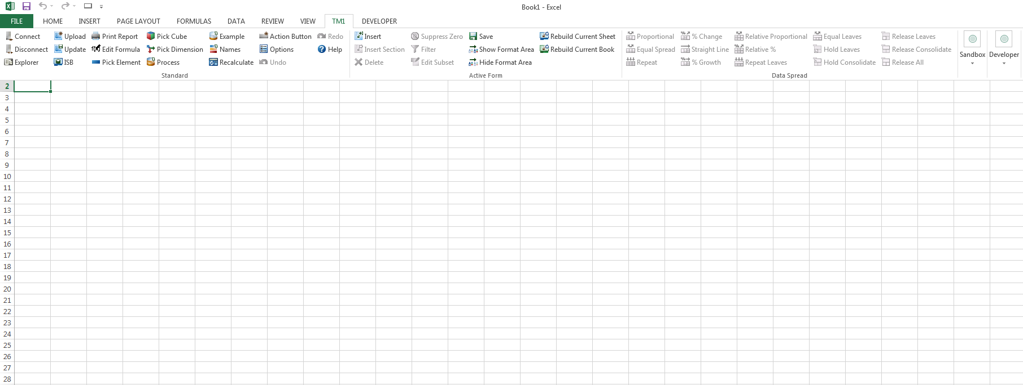
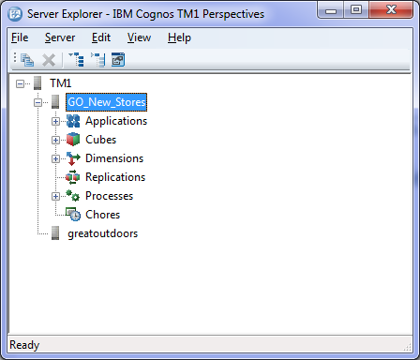
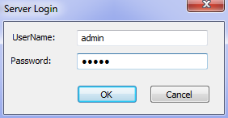
Starting TM1 Clients
Perspectives:
Program Files/Perspectives.
Double-Click the to Server to enter Credentials
7

Slide 4
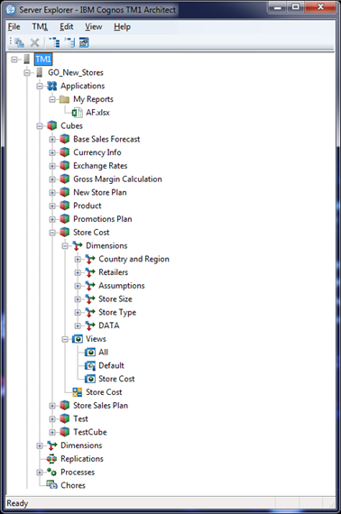
Server Explorer
The Server Explorer Window:
TM1Web Websheets.
Cubes.
Dimensions for the “Store Cost” Cube.
Saved Views for the “Store Cost” Cube.
All Dimensions on the “GO_New_Stores” Server.
10

Slide 5
Overview / Glossary
11

Slide 6
Cube
A cube stores data in a multidimensional form. Thus allowing users to slice n dice different perspectives of the data easily. A cube is made up of many dimensions.
Dimension
A dimension represents a business structure or those familiar with excel; a field of data in a pivot table. Examples are; GLAccount, Month, Year, Branch, etc.
Element
An element is an item in a dimension, it could be an individual gl account or month. There are 3 different types of elements, N, C & S.
N = Numerical data is stored
C = Consolidation of other elements
S = String or Text data is stored.
Cube Viewer
12

Slide 7
View
A view is a defined perspective or view of a cube. A view does not store data (a cube does), the view represents the selection of elements and placement of dimensions in the cube.
Subset
A subset is a defined selection of elements in a dimension. A subset allows users to easily find elements they use often, or to allow quick updating of views with changes to subsets.
Cube Viewer
12

Slide 8
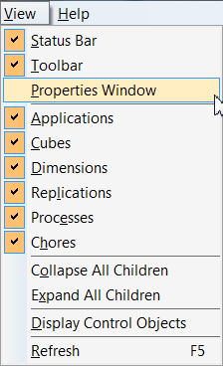
Properties Window

Slide 9
Browsing Data
11

Slide 10
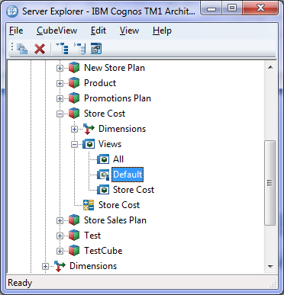
Cube Viewer
In the Server Explorer Window, double-click the cube name or expand the Views and double-click a View.
Server Explorer
Cube Viewer
12

Slide 11
Reload View
Auto Recalculate
Supress Zero
Commit Data
Select View
Snapshot
Redo Data Entry
Sandbox
Slice
Undo Data Entry
Save View
Recalculate
Layout
Select Sandbox
Active Form
Notes:
You can use Undo to revert data entry changes by storing a collection of data
maintenance actions.
You can use Redo to restore the change that was undone.

Slide 12
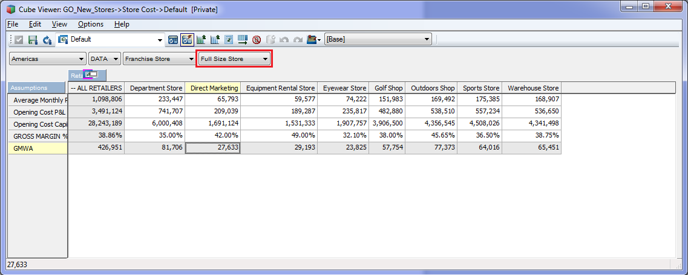
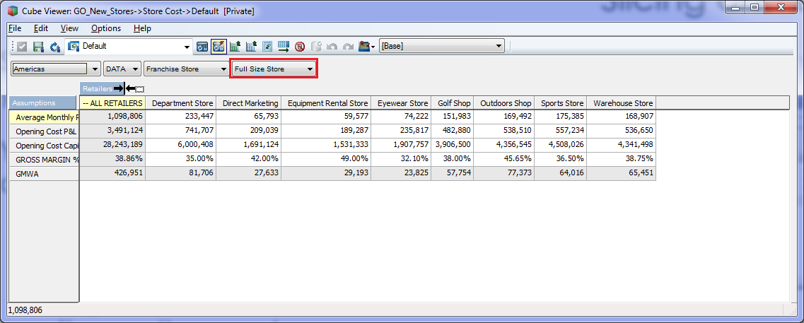
Slicing and Dicing
Slicing and Dicing is available in the Cube Viewer.
You can move dimensions around both on rows and columns:
Swap by moving a dimension on top of another one.
Drag a dimension before or after another one to NEST(combine) dimensions.
13

Slide 13
Recalculate and Display Data
The recalculate button ( )or F9 performs displays numbers and performs all calculations.
The Auto-recalculate button ( )displays data every time you move a dimension when slicing and dicing.
The Auto-recalculate button is a Toggle button is stays ON when selected.
It is recommended to switch off the auto recalculate option for larger cubes.
14

Slide 14
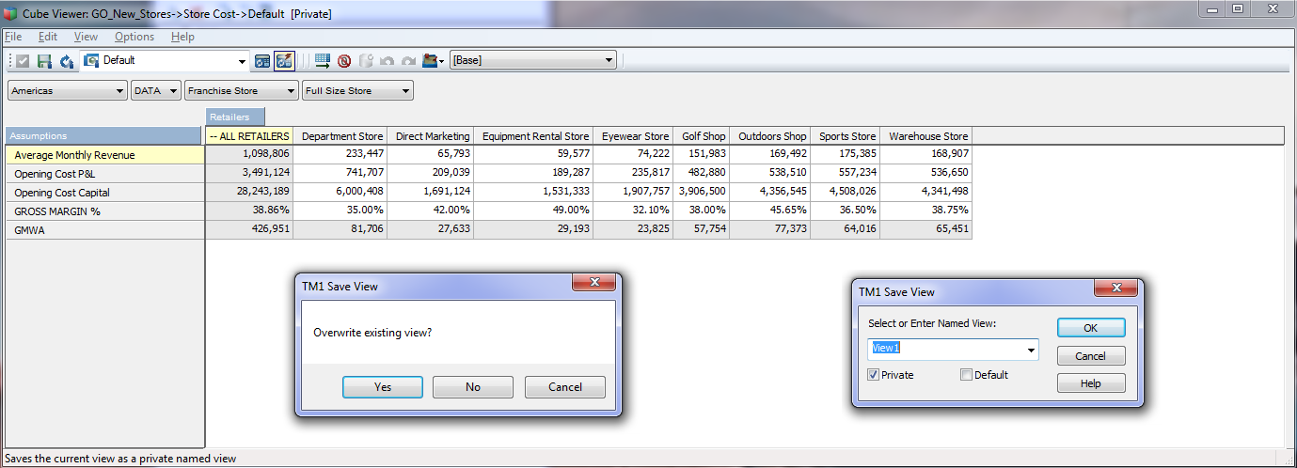
Saving a View
15
Notes:
The “save” button allows you to save a view.
You can overwrite the current view or create a new one.
View can be saved as “private or “public”. Only Administrator can save “public” views.

Slide 15
Understand Cell Data
Every cell value is located at the intersection of one element in each dimension.
All the cells that derive values through dimension consolidations or TM1 rules appear shaded in the Cube Viewer grid.
16

Slide 16
Stacking Dimensions

Slide 18
Working with Subsets
19

Slide 19
Element Selection
Subset are used to narrow the list of dimension elements displayed.
To Narrow your element list you can:
Selected Elements (click or ctrl-click) and decide to Keep ( ) or Hide ( ) them.
Filter By Wildcard (? Replaces a character and * replaces many characters).
Filter By Level: .
Filter by Attributes: .
Subsets can be saved for later re-use.
Private subsets are only available for the user that created it.
Public subsets can be used by everyone and the option is only available to Administrators.
20

Slide 20
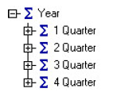
Element Order
Elements can be ordered using the following buttons:
Totals are display at the top by default but can be displayed at the bottom by using the Menu Option View/Expand Above in the subset editor Menu toolbar.
Alphabetical Descending
Alphabetical Ascending
Hierarchically
By Index Ascending
By Index Descending
21

Slide 21
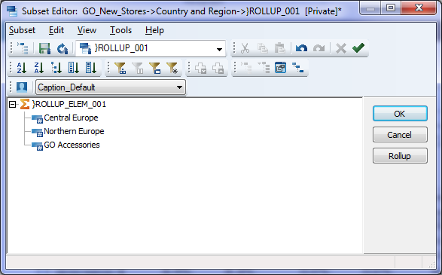
User Defined Consolidation
You can create dynamic aggregation using the “Rollup” button:
Select the elements you want to aggregate.
Click “Rollup” button.
22

Slide 22
Working with Views
23

Slide 23
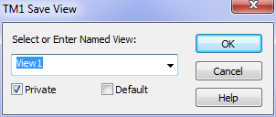
Create a View
After Slicing and Dicing a cube, you can save it as a View.
You can save a View as the Default View.
The Default View is used when double-clicking the cube.
View can be saved as “Private” or “Public”.
Only Administrators can save Public Views.
The “Auto Calculate” button state is saved as part of the View.
Views are used in Server Explorer, ISB and TM1Web.
24

Slide 24
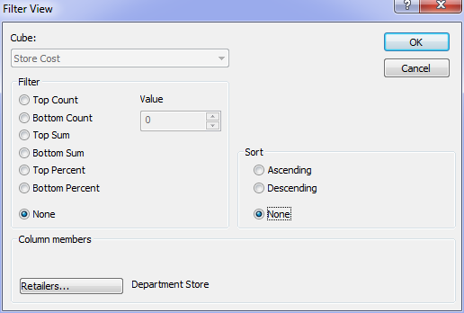
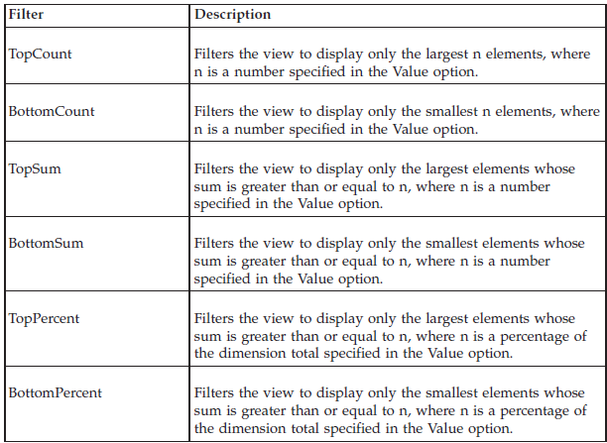
Filter a View
You can Filter information in a View buy right-clicking a cell.
The Filter will be applier to that same column containing the selected cell.
25

Slide 25
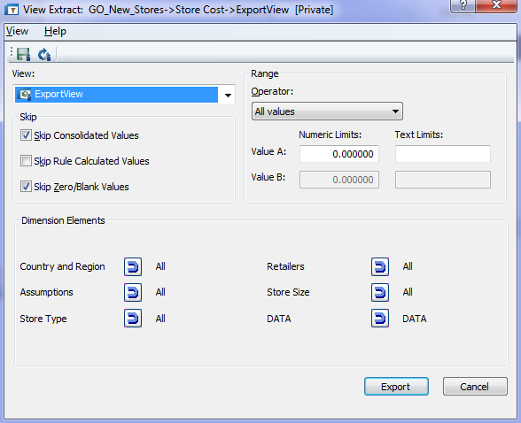
Export Data using a View
You can Export Cube Data into a text file.
The Export function is available from right-clicking a cube.
26

Slide 26
Updating Data
27

Slide 27
Updating Data
Only “leaf” level elements can be updated in TM1.
Data in TM1 can be updated using the following methods:
Manual update.
Data Spread Methods.
Turbo Integrator Process.
Rules.
28

Slide 28
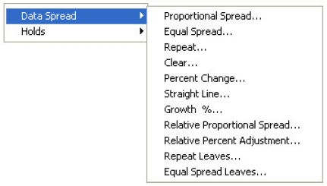
Data Spreading
Data Spreading is used for “top-down” type of data input.
There are 11 Pre-Defined Methods to choose from.
You cannot initiate spreading from a non-contiguous range of cells, nor can you spread data across multiple individually selected cells or ranges in a worksheet or cube view.
Data Spreading is available from all TM1 Clients.
29

Slide 29
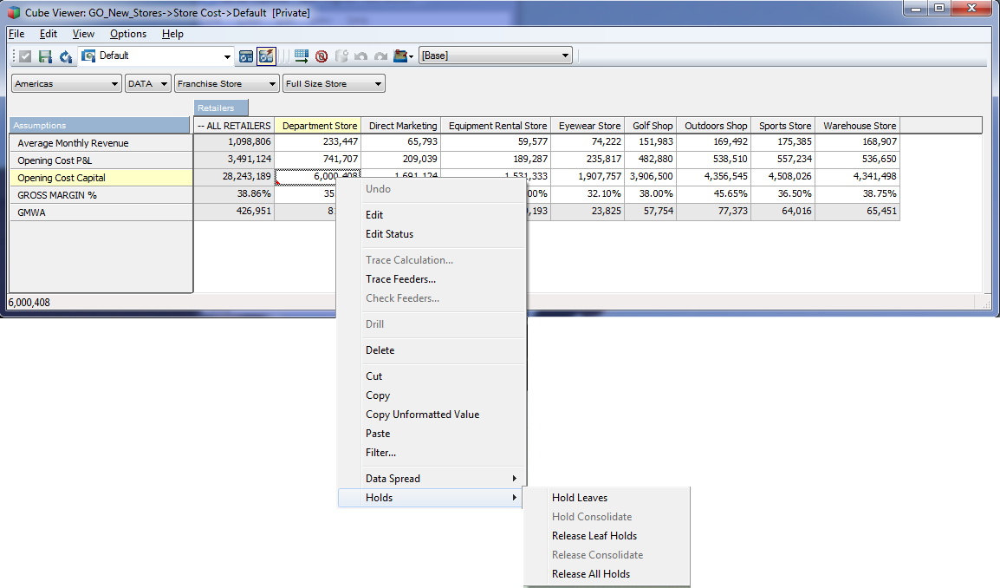
Holding values
The Consolidation Hold feature lets you hold the value of a consolidation constant while adjusting the underlying leaf values.
30

Slide 30
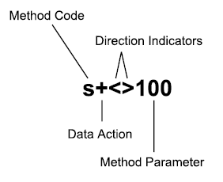
Data Spreading Syntax
You can apply most data spreading methods through a special syntax that you enter directly in cells in the Cube Viewer, In-Spreadsheet Browser, and slice work sheets. The syntax also allows you to apply and release holds.
31

Slide 31
Data Spreading Syntax
Sandboxing give you the ability to run “What-if” scenarios without impacting the real data.
This feature is available in all end-user tools: (Cube Viewer, Perspectives and TM1Web.
32

Slide 32
TM1 Worksheets
33

Slide 33
Create a TM1 Worksheets
When using the Server Explorer from Perspectives, you can present the TM1 data in Excel.
Three options are available:
Snapshot.
Slice.
Active Form.
Slice
Active Form
Snapshot
34

Slide 34
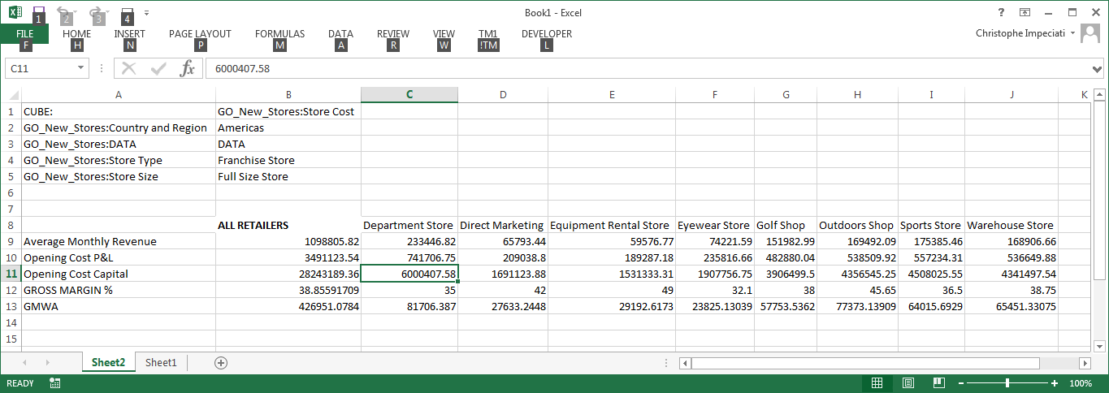
Snapshot
A snapshot contains the TM1 data at the time the Snapshot was created.
It does not communicate with TM1.
It is useful for archiving data of sending data to a non-TM1 user.
35

Slide 35
Slice
When you create a slice, TM1 generates a worksheet populated with functions. These functions display the current TM1 values in the worksheet. The functions are bi-directional; they retrieve and display the current cube values, but when you update a value in the worksheet, the function also sends the new value to the appropriate cube.
The two main function in a Slice are:
DBRW (read/write data from and to TM1).
SUBNM (trigger the subset editor for element selection).
36

Slide 36
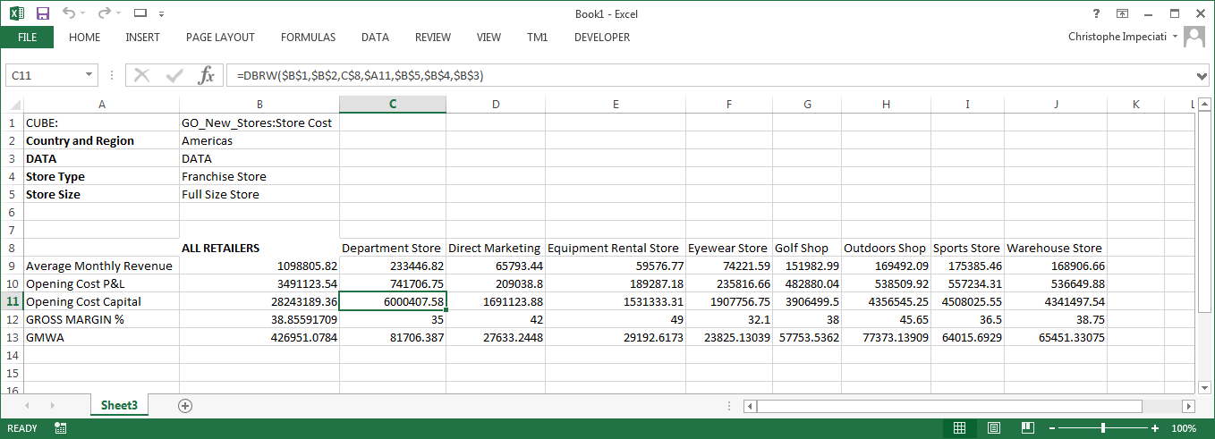
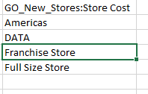
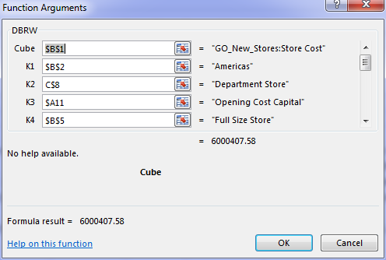
Slice (cont.)
37

Slide 37
Modifying Worksheets
You can modify the Worksheets using the following techniques:
Changing element names by:
Type valid element names in the worksheet cells.
Copy element names from the TM1 client window.
Use the TM1 worksheet function that retrieves the element names.
You can create new references by using the Formula Editor (from the TM1 menu/edit formula).
38

Slide 38
Active Form
Like a Slice an Active Form lets you interact with TM1 data using an Excel front end, but it offers the following extra capabilities:
Expandable row information.
Zero suppression.
Stackable row information (sections).
Imbedded formatting area, allowing you to colour hierarchical levels.
Dynamic rows using:
Subsets.
MDX.
39

Slide 39
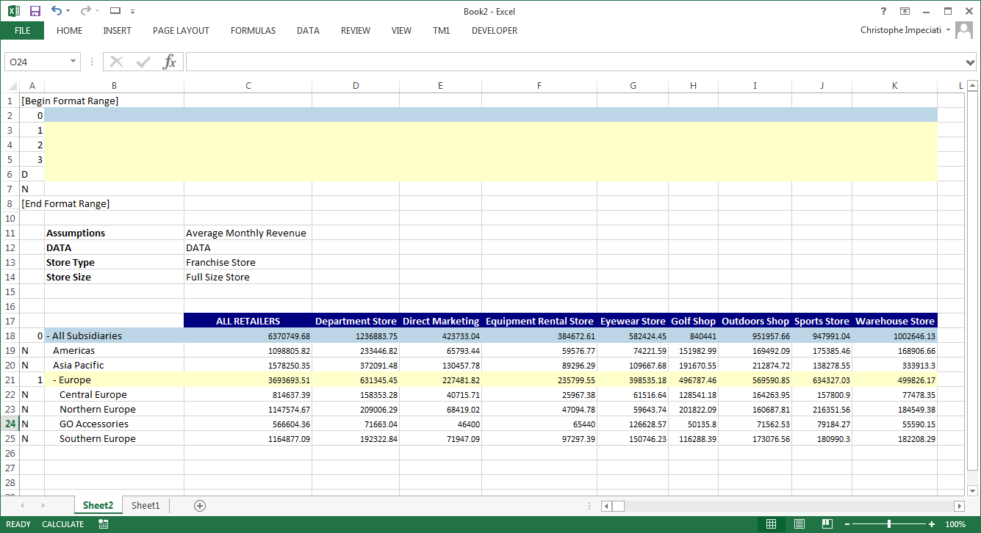
Active Form (cont.)
Format Area (Hidden by default, must “show format area”)
Column A indicates which format is applied to the row.
Dynamic rows using the TM1RPTROW function.
Click the first row of the row block to display the function.
40

Slide 40
TM1 Reports
41

Slide 41
Overview
Using the TM1 Print Report Wizard, you can generate TM1 reports that you can share with other people in your organization in a number of ways:
Print the report to a printer.
Save the report as an Excel document (can strip off TM1 functions).
Save the report as a PDF document.
To generate reports, use the TM1 Menu/Print Reports and follow the Wizard.
TM1 Reports
42

Slide 42
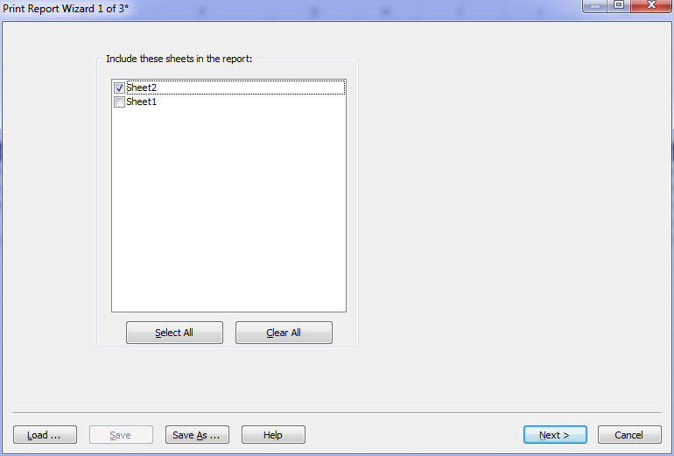
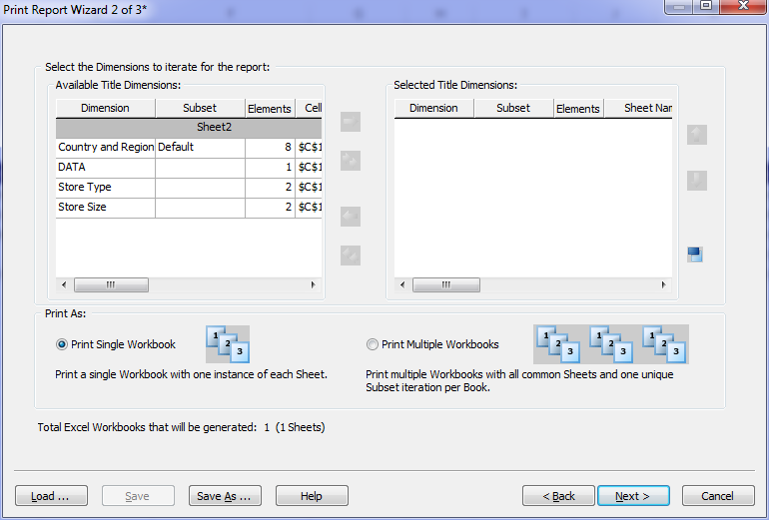
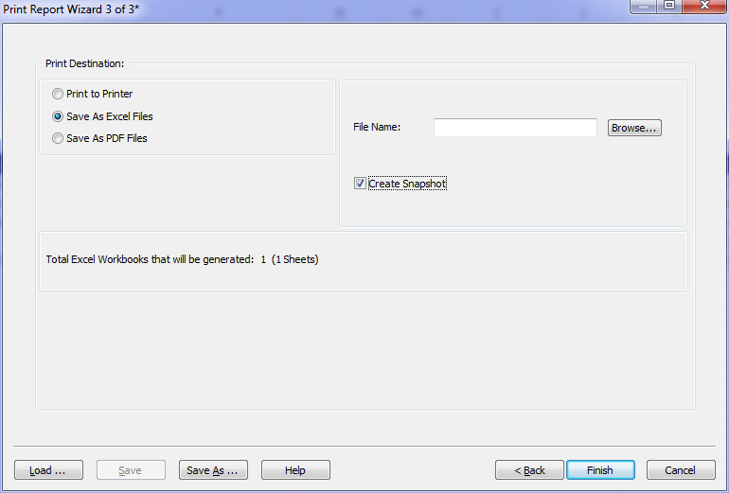
TM1 Report Wizard
Step1:
Select sheet(s)
Step2:
Select one workbook or multiple sheets within the same workbook.
Sheets will be generated based on each element of the dimensions(s) you place in the right screen.
Step3:
Select the output format.
Tick the snapshot box to remove TM1 formulas.
43

Slide 43
TM1 Web
44

Slide 44
Overview
IBM Cognos TM1 Web extends the analytical power of TM1 Web by offering a number of tasks in a web browser:
Analyse cube data.
View, Edit data in formatted Excel Websheets.
Drill, pivot, select and filter data.
Build charts from cube data.
IBM Cognos TM1 Web is a zero footprint application that can be accessed from any computer through a Web Browser using the following URL: http://MachineName:9510/TM1Web
45

Slide 45
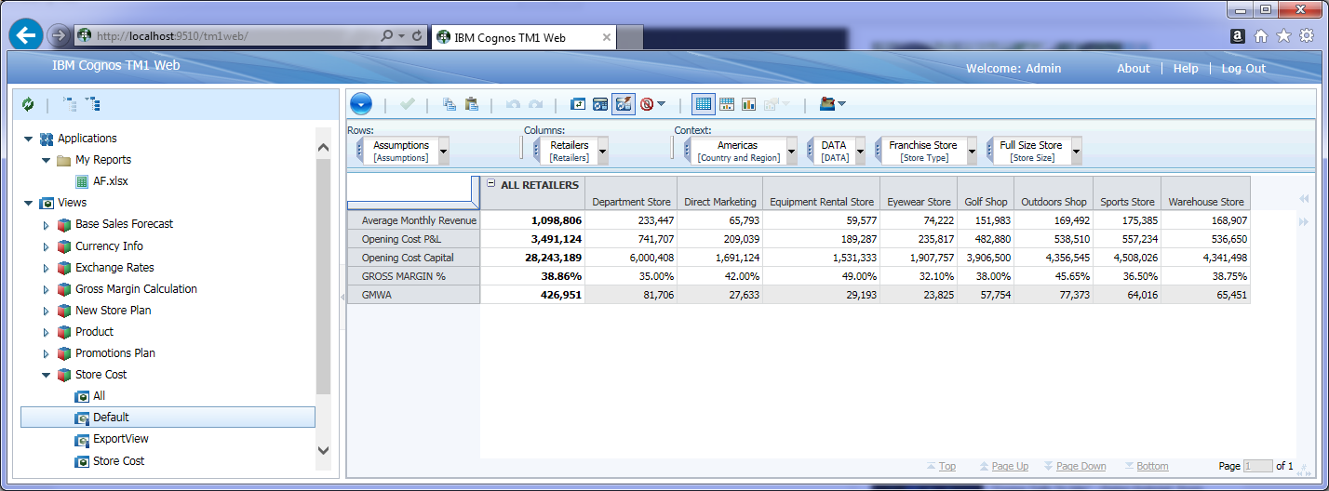
TM1Web interface
Applications:
Folders
Websheets (Excel front end to TM1)
Cube Views:
Contains all Views you are entitled to see.
46

Slide 46
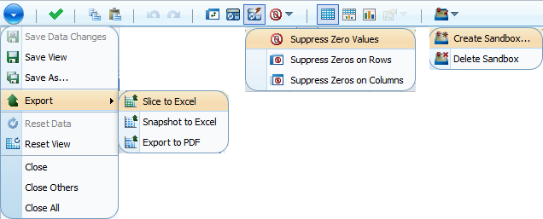
TM1Web Toolbar
Undo/Redo (Data changes)
Re-calculate:
Once (F9).
Permanent.
Display type:
Crosstab only.
Crosstab and Chart.
Chart only.
Copy/Paste
Zero Suppression:
Rows.
Columns.
Commit Data when Sandboxing.
Sandboxing (What-if scenarios).
Action Button:
Save Views.
Exports.
Reset the View.
Swap rows and columns
47

Slide 47
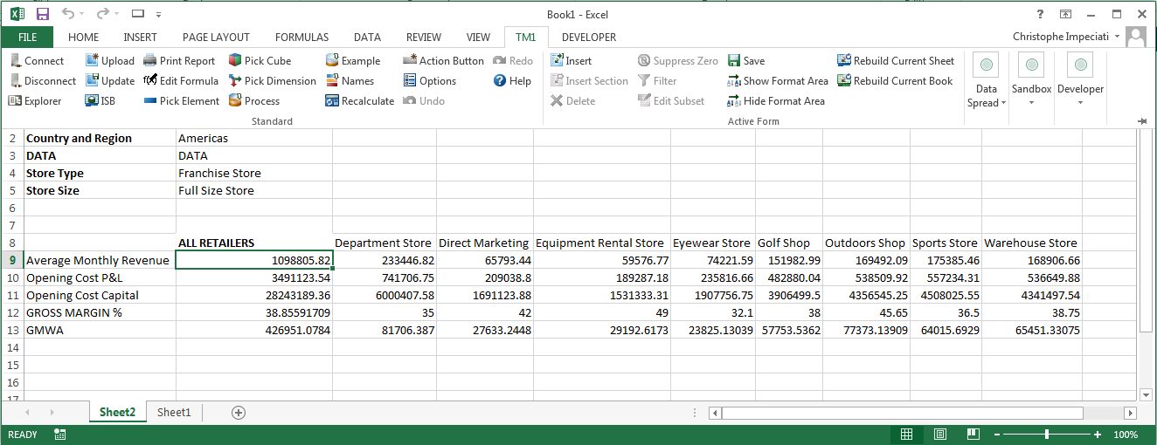
TM1 Websheets Upload/Update
Websheets:
Upload (new).
Update (replace existing).
48

Slide 48
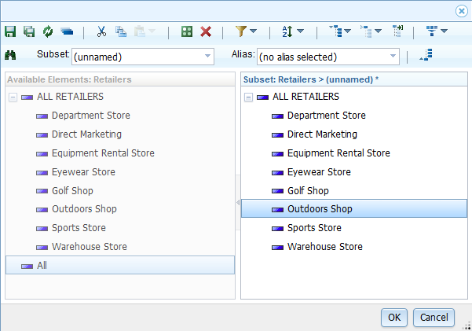
Edit Subsets in TM1Web
Reload Subset.
Cut/Copy/Paste.
Keep/Delete selected Element(s).
Sort.
Select All Elements.
Expand/Collapse Levels.
Create custom aggregation.
Save Subset.
Filter.
Make sure you click the right pane( highlighted when active).
49

